Slide 1
Cisco Networking Academy
Education, technical training and mentorship
Name
Title
Date

Slide 2
Model Driven Programmability
Chapter 2: YANG, RESTCONF & NETCONF
Presenter Name
Presenter Info (Title, School, etc.)
Date

Slide 3
Introduction

Slide 4
Welcome

Slide 5
Agenda
Network Programmability
Programming Network Devices
YANG device models
Experimenting with RESTCONF and NETCONF protocols

Slide 6
Workshop Objectives
At the end of this workshop you will be able to:
Explain basic concepts of Model Driven Programmability
Explain YANG models for networking devices
Explain how YANG modes are being used with RESTCONF and NETCONF protocols
Write simple Python scripts to interact with devices using RESTCONF and NETCONF
Please note: You are NOT expected become software developers or network programmers - yet!

Slide 7
Computer Requirements
Python and IDLE
Installed Python Modules:
requests (pip install requests)
pyang (On MS Windows: pip install --no-binary pyang pyang On Linux/Mac: pip install pyang)
ncclient (pip install ncclient)
xmltodict (pip install xmltodict)
The Postman application
Notes:
You were given a list of things that you need to already have installed on your computer so that we can do our hands-on tasks.
First, has everyone been able to install IDLE and Python 3? Python 3 should be in your path environment variables so that Python can locate the modules that you need to find. You can test this by opening a command window and typing python. The prompt should change to the Python prompt. If you get an error, Python needs to be reinstalled and included in your path.
Second, two Python modules also needed to be installed using the PIP package manager. Were you able to get requests and pyang, ncclient and xmltodict installed?
Finally, each of you need Postman for the workshop. Do you all have working version of the Postman application?

Slide 8

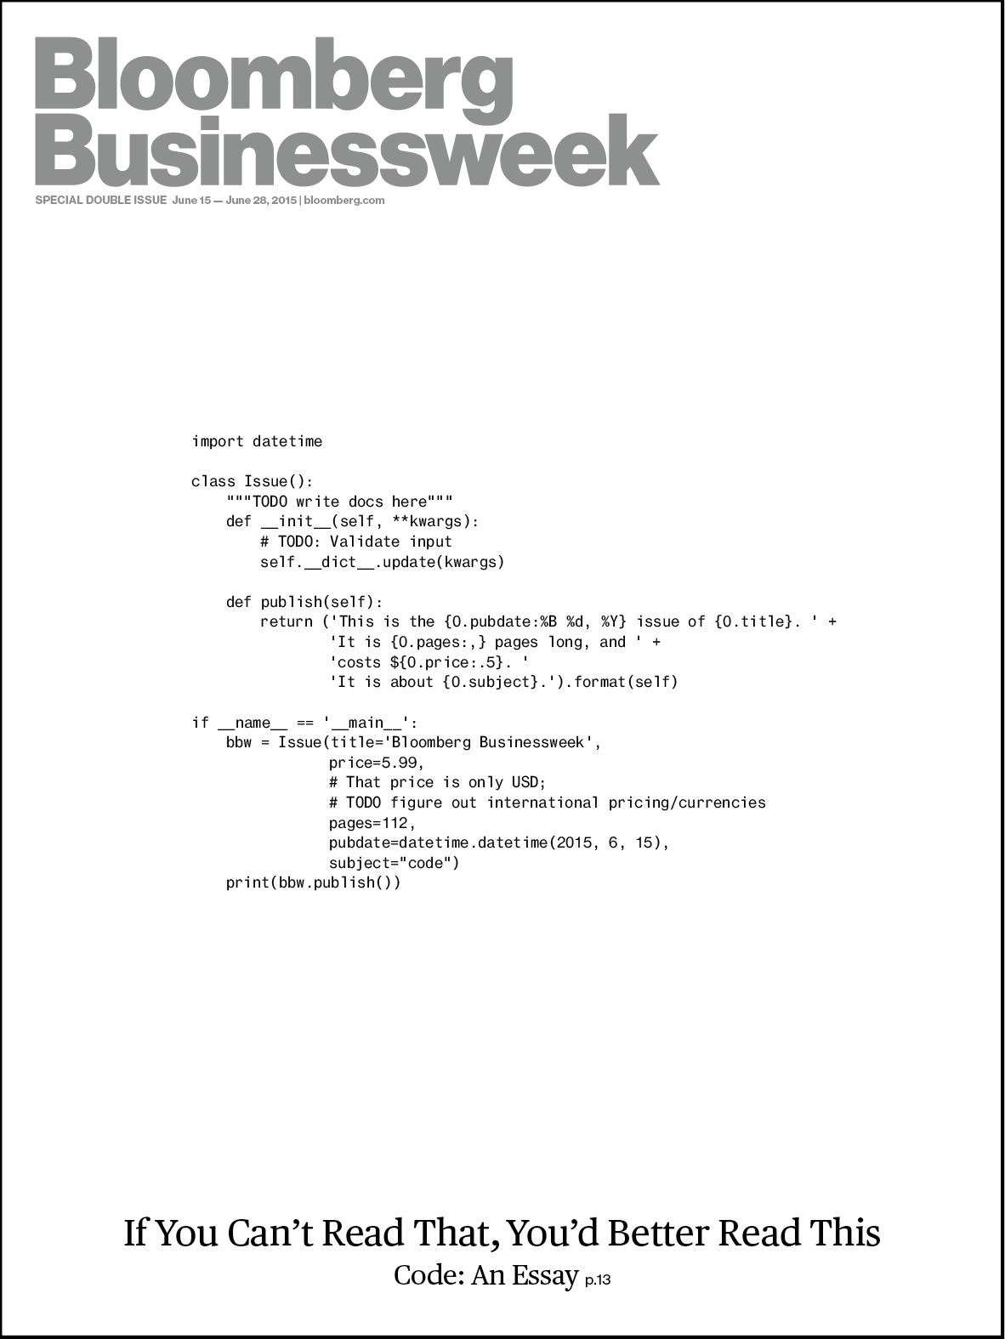



Why are we here?
Everything
becomes
connected
Everything
becomes
software-based
Everything
generates
data
Everything can be
automated
Everything
needs to be
secured
Notes:
Data networking is experiencing a period of disruption. We were pretty comfortable for many years with our routing and switching world. However, things have been heating up for some time now. We have the Internet of Things which is connecting millions of devices to the internet. We know that this trend is expected to become ubiquitous in the near feature. There are great opportunities in the IoT job market for our students. In addition, we are seeing a trend toward programmability. Cisco is redefining itself as a software and services company in addition to its role as a leader in providing networking hardware. Along with the move towards digitization everywhere comes the opportunities and demands of Big Data and Analytics. In addition, automation becomes available in a software-based networking world. The network can become adaptive and intention-based. Instead of the network being the same for all business needs, it can mold to the applications running on the network as defined by business requirements. Finally security needs to be everywhere, especially with millions of things attaching to the network.
As you have seen, the Networking Academy Program is working to provide your students with expanded offerings in all of these areas, and will continue to do so. You are here today to gain knowledge and skills about the programmability aspects of the emerging network.

Slide 9
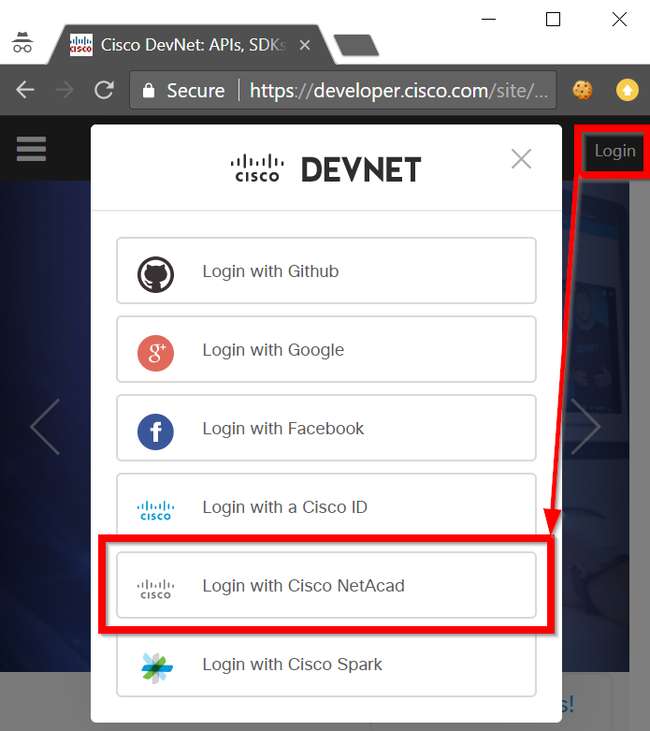

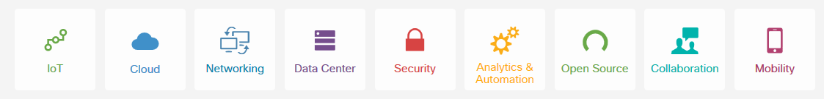








Building an Industry Ecosystem with DevNet
Enabling developers
and learners
Vibrant Developer Ecosystem
Developer as the customer
Catalyze & Accelerate Digitization
Cisco’s Developer
Community and Innovation Ecosystem
Cisco’s portfolio as a Platform for Innovation
https://developer.cisco.com
IoT
SDN
Cloud
Collaboration
Security
Data Center
DevOps
Service
Open Source
Notes:
DevNet, formerly known as the Cisco Developer's Network, is a place for developers to test out software with actual Cisco networks and devices that are programmable. DevNet offers numerous sandboxed virtual environments that are either open or reservable by registered users. In addition, DevNet offers many learning tracks and hours of courses designed for networking professionals who are learning network programmability. The Networking Academy Program is working with DevNet to bring learners and developers together in a powerful ecosystem. DevNet access is free.
Please visit DevNet and login as a NetAcad user so that you can explore what DevNet has to offer you as Networking Academy instructor.

Slide 10
Network Programmability

Slide 11
Network Programmability Concepts

Slide 12
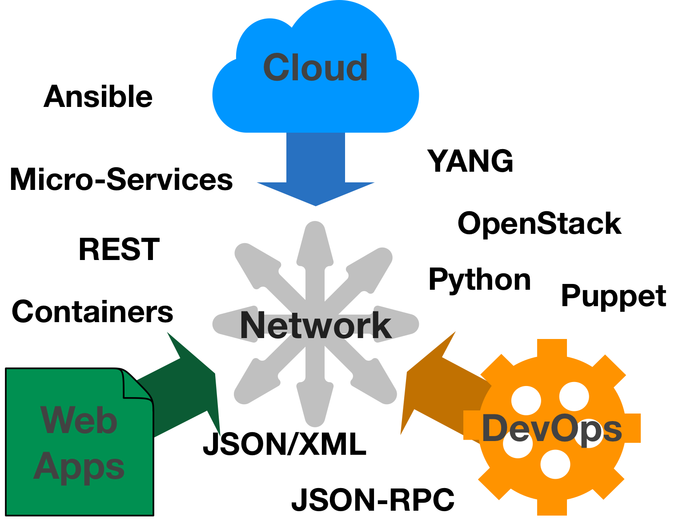
The Network is No Longer Isolated
Notes:
Network Engineers leveraging CLI are no longer the only parties interested in configuring and monitoring the network. And using the CLI is no longer the only method to configure and monitor the network.
DevOps is an approach to development and operations that has proven successful for many organizations, and these teams are quickly looking at how they can expand their reach into the network.
New Web Applications leveraging Micro-Service architectures are building overlay container networks, but as the model matures, these applications look to integration with the underlying network for performance and segmentation.
And the "Cloud" is no longer a destination, but rather a complete approach to delivering IT Services and Applications. This approach demands fully programmatic (ie through APIs) access to services. Consumers aren't interested in individual devices and feature configuration, but rather the capabilities that the network can provide.

Slide 13
SDN: Control Plane and Data Plane
Control Plane
Hardware | Purpose | Example Processes
Device CPU | makes decisions about where traffic is sent | routing protocols, spanning tree, AAA, SNMP, CLI
ingress
egress
Data Plane
Hardware | Purpose | Example Processes
Dedicated ASICs | forwards traffic to the selected destination | packet switching, L2 switching, QoS, policies, ACLs
Notes:
In the networking devices that we are most familiar with, we really don’t make much of a differentiation between what is known as the control plane and data plane of the device. We tend to think of a router or switch as a single device. We do recognize that a management plane exists, however. For example, we tell students that switches are Layer 2 devices, however we then proceed to tell them to assign them with IP addresses! That is because the management plane is separate from the role of the device in the network.
Now however, we are seeing not only management, but also the actual “brains" of a network device as separate from the traffic forwarding processes of the device. This separation allows centralization information that devices uses to make forwarding decisions and perform other functions.

Slide 14
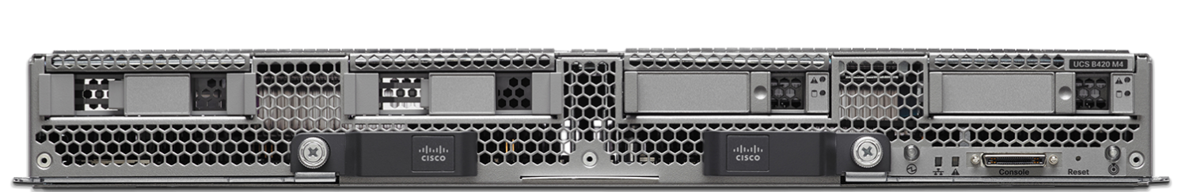
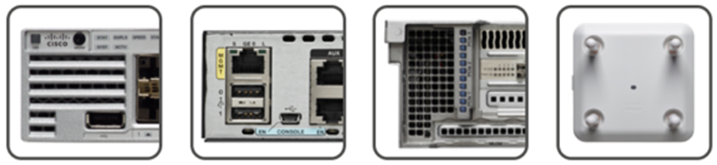


Data Control and Management plane
WebUI
Orchestration
Business apps
Collaboration
Applications
Monitoring
Policy
Troubleshooting
. . .
REST APIs
Northbound APIs
SDN Controller / NMS
SNMP
SSH
Telnet
NETCONF
RESTCONF
…
Southbound APIs
Physical Topology
(data plane fabric)
Computers, Servers, IoT, etc.

Slide 15
Programmable API interfaces for the network
Network Controllers Programmability
REST APIs for
APIC-EM
DNA-C
Other network controllers
Device Level Programmability
YANG models
NETCONF
RESTCONF

Slide 16
Model Driven Programmability
Device Level Programmability
Configure new services, or set up new configuration device by device
Transactions – either all device changes succeed, or the whole transaction is rolled back
Clearly defined models of network devices and services
Models define the functions and features of devices and their configuration
Models define operational and statistical data
Models define the schema – what data are available, what are the parameters, data types (string, number, Boolean, …), etc.

Slide 17
Programming Network Devices

Slide 18

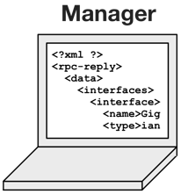
Device Level APIs and Programmability
Configure device by device using APIs
Some remote management protocols
Telnet SSH
NETCONF
RESTCONF SNMP …
…
…
Network Operator’s PC or an NMS
…
Network Devices

Slide 19
Management over CLI (Telnet, SSH)
Commonly used, well known, used for initial device configuration, etc.
Automation/Programmability challenges
Unstructured Data
show version
Validating Change
int loopback 1 description Customer1 ip address 10.1.1.1 255.255.255.0 int loopback 2 description Customer2 ip address 10.1.1.1 255.255.255.0
What’s the problem?
What will be the resulting configuration?

Slide 20
2.1 LAB – Setting Up the Lab Environment

Slide 21
What’s the lab about?
Set up access to a router with programmable API interfaces
Local VM with IOS XE (Virtualbox)
DevNet Sandbox
Local ISR4k Router
Verify the SSH remote connection to the device

Slide 22
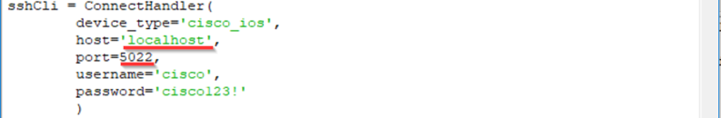
The lab activities were designed with the “Local VM with IOS XE” option. If you are using one of the other lab equipment options, adjust the hostname or the IP address and the port of the IOS XE router accordingly. Use the table below as a reference:
 | Local VM with IOS XE | DevNet Sandbox | Local ISR4k Router
Hostname/IP address | localhost | 10.10.20.48 | Any IP address configured on the ISR4k router reachable from your computer
Ports | SSH: 5022 NETCONF: 5830 RESTCONF: 5443 | SSH: 22 NETCONF: 830 RESTCONF: 443 | SSH: 22 NETCONF: 830 RESTCONF: 443
Credentials | L: cisco P: cisco123! | L: cisco P: cisco_1234! | L: cisco P: cisco123! (or your locally defined combination)
Example of a required change (replace “localhost” and port “5022” and if needed, also the username and password options):
Lab 2.2 Part 2c
Lab 2.4 Part 1 Step 2b:

Slide 23
2.2 LAB – CLI Automation with Python Using netmiko

Slide 24
What’s the lab about?
Learn how to use Python to manage network devices using SSH
Learn about the “netmiko” Python module
Experiment with netmiko to get a device’s configuration and operational data:
Unstructured data
“What if, in the next revision of the network OS, the developers decide to add a netmask into the sh ip int brief command output?”
Experiment with netmiko to alter the device configuration:
No easy way to verify that the change has been accepted
No error handling over CLI – copy & paste & cross-fingers it works!

Slide 25
YANG Models

Slide 26
What is a Data Model?
Defines the exact structure, data types, syntax and validation rules for the content of messages exchanged between a managed device and another system communicating with the device.
A data model is simply a well understood and agreed upon method to describe "something". As an example, consider this simple "data model" for an interface:
interface
name [String, max 32 chars]
enabled [Boolean]
description [String, max 64 chars, optional]
IPv4 Address [Dotted Decimal]
IPv4 Netmask [Integer, prefix length]
…
Notes:
Using the generic data model, we can describe an individual as a "Brown hair, blue eyed, five foot woman of about 120 pounds" and anyone understands what this means.

Slide 27
YANG Modeling Language
Module that is a self-contained top-level hierarchy of nodes
Uses containers to group related nodes
Uses lists to identify nodes that are stored in sequence
Each individual attribute of a node is represented by a leaf
Every leaf must have an associated type
module ietf-interfaces {
import ietf-yang-types {
prefix yang;
}
container interfaces {
list interface {
key "name";
leaf name {
type string;
}
leaf enabled {
type boolean;
default "true";
}
}
Example edited for simplicity and brevity
Notes:
YANG is first a language for describing data models. The YANG language could be used to describe ANY data model, but it was designed to describe networking data models.
As a language, it is highly structured and typed, which is best practice in a data modeling language . Some aspects of the language to note:
Every data model is a module that is a self-contained top-level hierarchy of nodes
Leverages data types that can be imported from another YANG module, or defined within a module
Uses containers to group related nodes
Leverages lists to identify nodes that are stored in sequence
Each individual attribute of a node is represented by a leaf
Every leaf must have an associated type
What you need to know to get started
YANG the language can be very intimidating when just getting started. It is a robust language tasked with describing complicated topics. What is important at this stage of your use is to recognize that YANG is a data modeling language and to be able to generally read examples. You will not need to write in YANG for some time, if ever.

Slide 28
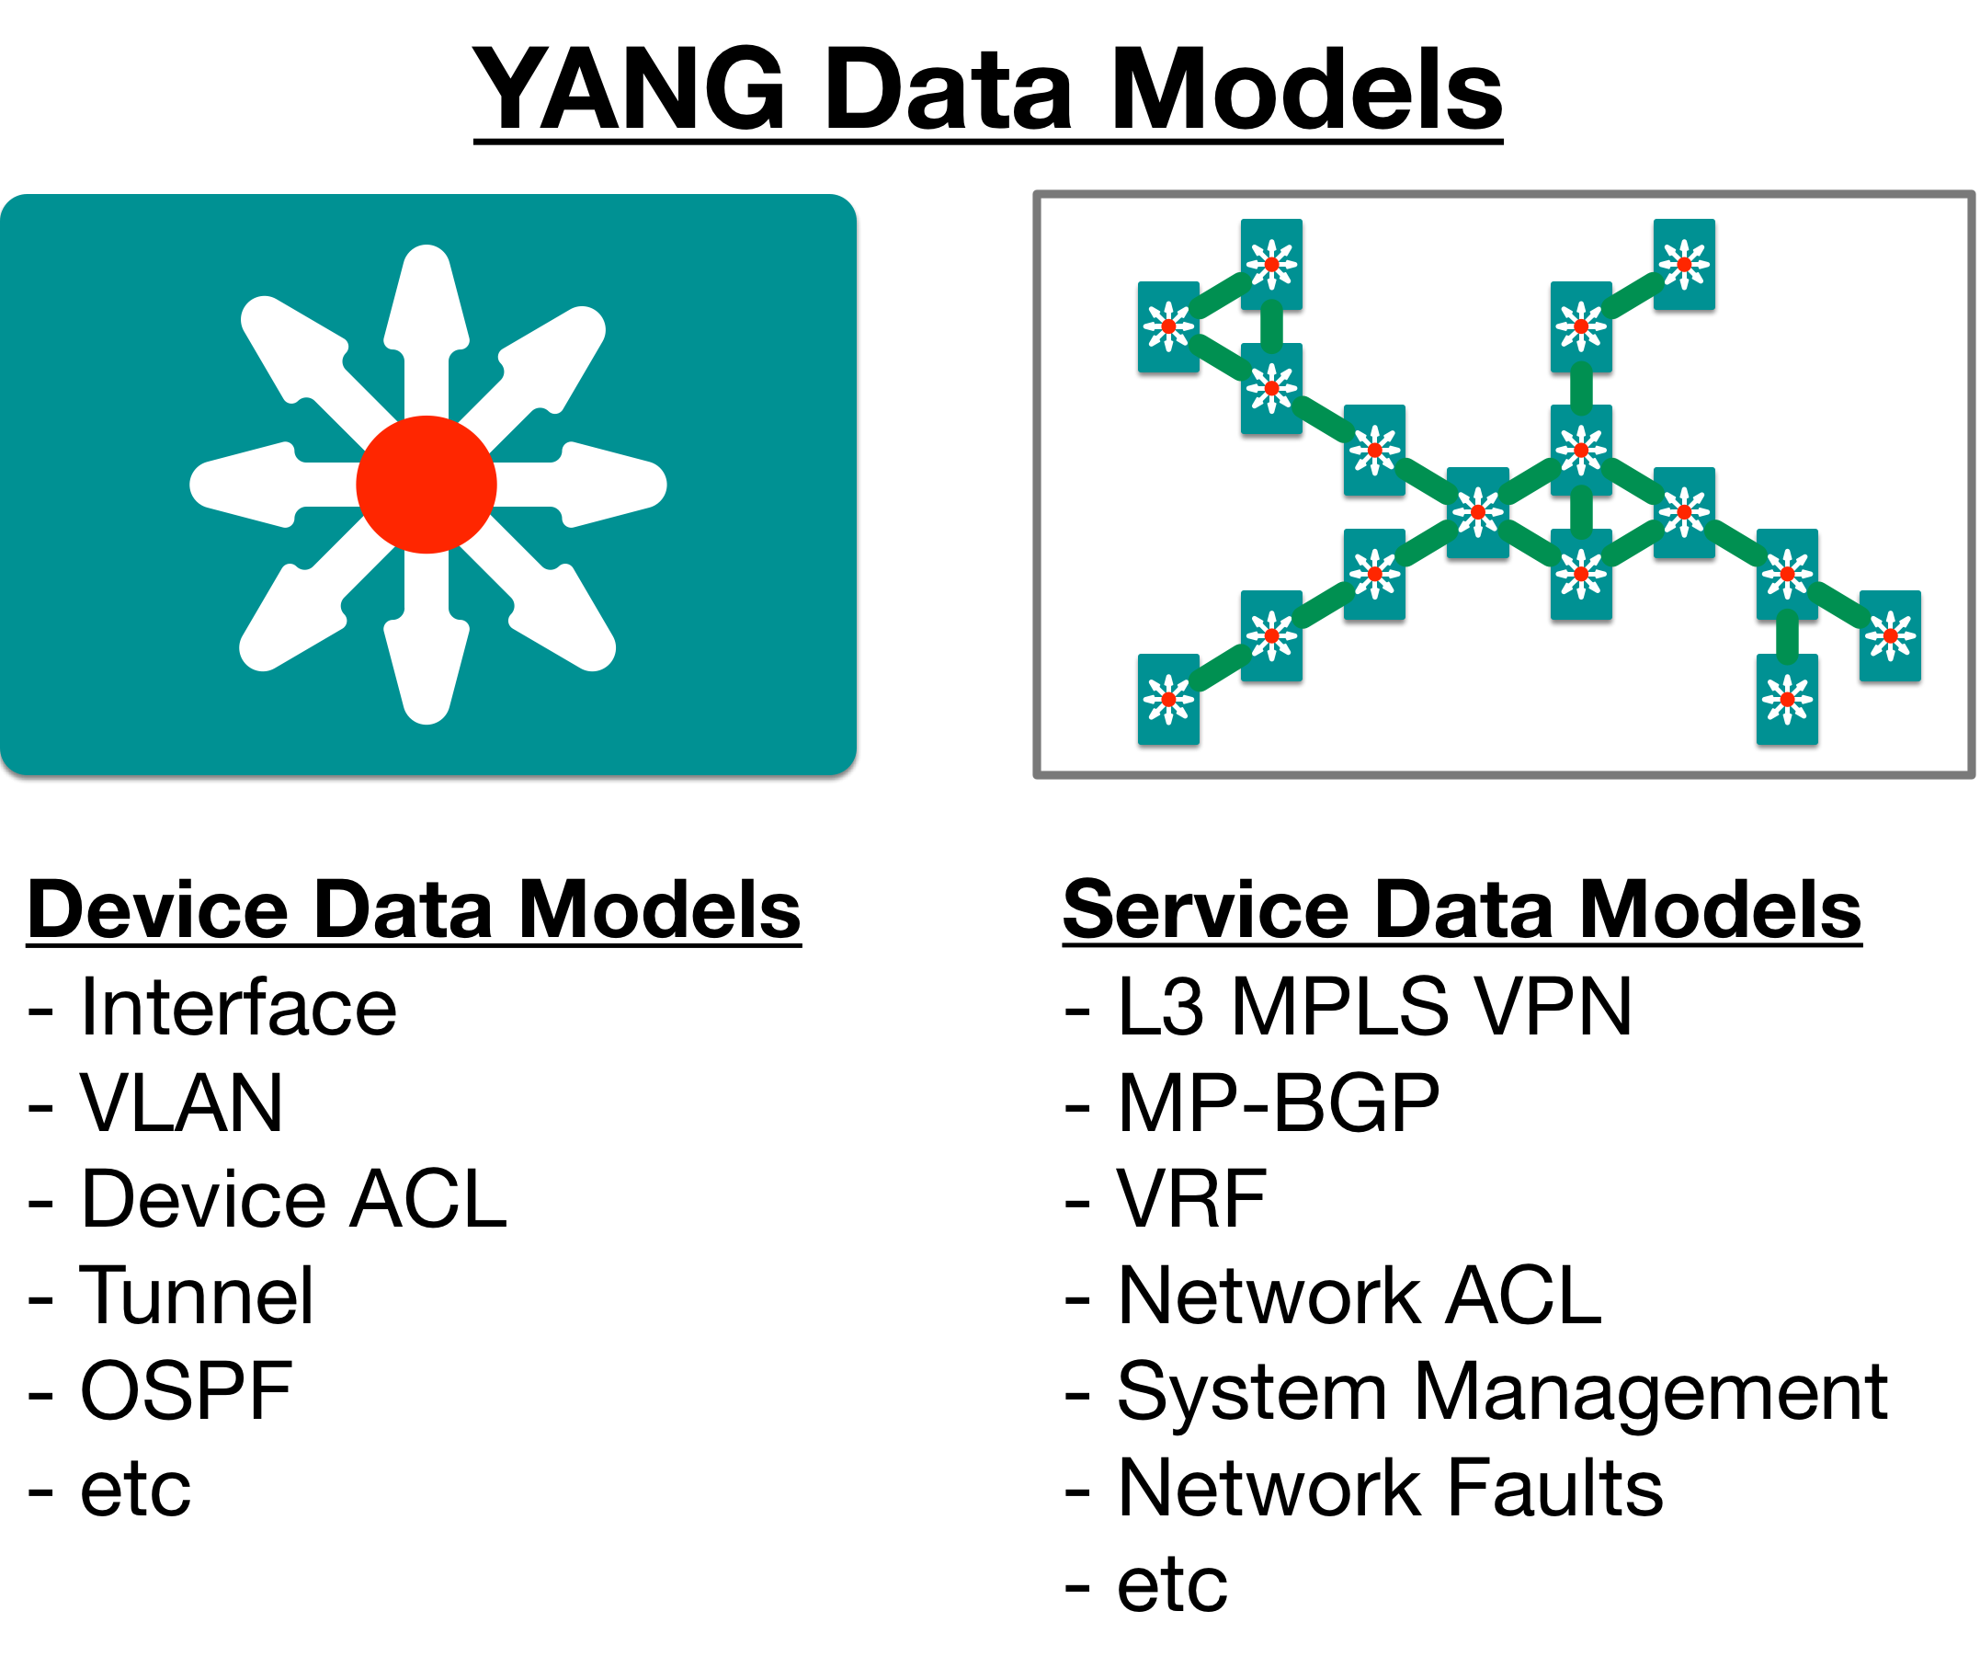
What might a YANG Data Model describe?
Notes:
Secondly, in this part, we will be focusing on investigating and leveraging YANG Device Data Models to directly inspect and configure network elements. However, YANG Data Models are also available, and being developed, that represent a "Network Service" to describe a network construct that spans across an entire network.
For example, draft-ietf-l3sm-l3vpn-service-model-19 is:
“a YANG data model that can be used for communication between customers and network operators and to deliver a Layer 3 Provider Provisioned VPN service”
Typically the Service Data Models would be supported on Network Orchestration solutions rather than directly by individual network elements. Network operations would use the Service Models to describe the needs across the network within the orchestrator which then leverages Device Data Models to perform the actual end configuration.

Slide 29
Where do Models Come From?
Industry Standard
Vendor Specific
Standard definition (IETF, ITU, OpenConfig, etc.)
Compliant with standard ietf-interfaces.yang ietf-diffserv-policy.yang ietf-diffserv-classifer.yang ietf-diffserv-target.yang
Vendor definition (i.e. Cisco)
Unique to Vendor Platforms cisco-memory-stats.yang cisco-flow-monitor cisco-qos-action-qlimit-cfg
Notes:
Wait... I'm sure you're asking yourself, "Who writes YANG Models?". Well that is a great question. Technically anyone can write a YANG Model, all it takes is an idea and a knowledge of the YANG Language. However for practical purposed, the most used models come from one of two places.
Debating the pros and cons of individual models, and the different sources is beyond the scope of this presentation ;-)

Slide 30
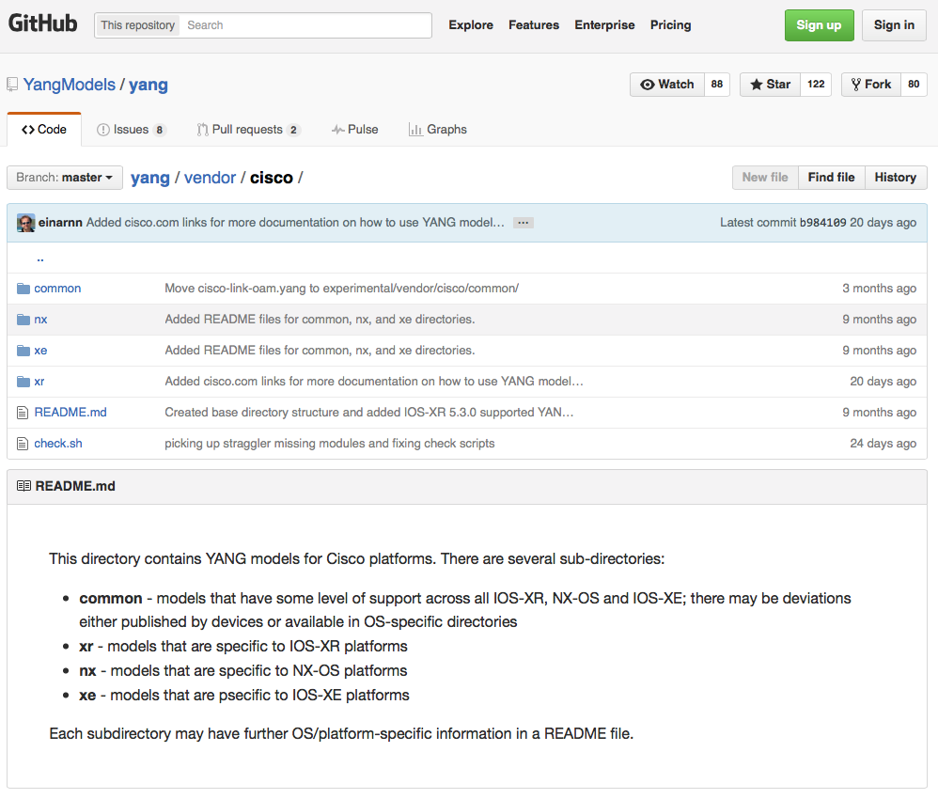
Where to get the Models?
For YANG models from standard organizations such as the IETF, open source such as Open Daylight or vendor specific modules”
https://github.com/YangModels/yang
For OpenConfig models
https://github.com/openconfig/public

Slide 31
YANG Data Models
The model can be displayed and represented in any number of formats depending on your needs at the time. Some options include:
YANG Language
Clear Text
XML
JSON
HTML/JavaScript
Notes:
A language isn't very useful if you don’t do something with it, and the YANG language is used to write YANG Data Models. An individual data model, called a "YANG Module", will describe some aspect of networking.

Slide 32
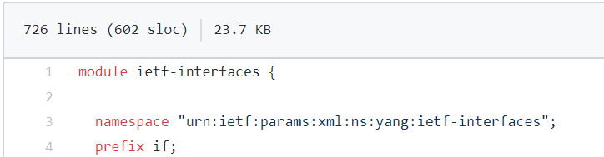
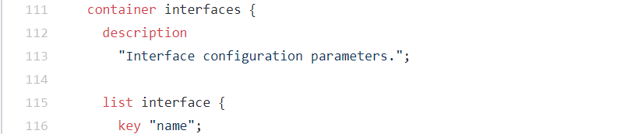
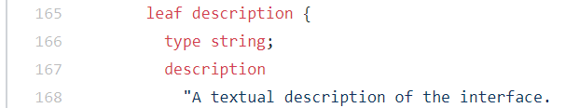
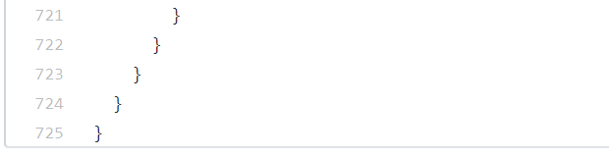
Working with YANG Models
“yang model in yang language”
“yang model transformed into a human readable tree view”
DevNet$ pyang –f tree ietf-interfaces.yang
module: ietf-interfaces
+--rw interfaces
| +--rw interface* [name]
| +--rw name string
| +--rw description? string
| +--rw type identityref
| +--rw enabled? boolean
| +--rw link-up-down-trap-enable? enumeration {if-mib}?
…
vs.
…
…
Example output edited for simplicity and brevity
Notes:
An important aspect of developing with new languages and APIs, is having access to tools and utilities that make the job easier. One very helpful tool for working with YANG Data Models is pyang, a YANG validator, transformator and code generator written in Python. We will use this tool to take a look at a few basic YANG Models.

Slide 33
Using pyang tool
Module Name
module: ietf-interfaces
+--rw interfaces
| +--rw interface* [name]
| +--rw name string
| +--rw description? string
| +--rw type identityref
| +--rw enabled? boolean
| +--rw link-up-down-trap-enable? enumeration {if-mib}?
+--ro interfaces-state
+--ro interface* [name]
+--ro name string
+--ro type identityref
+--ro admin-status enumeration {if-mib}?
+--ro oper-status enumeration
+--ro last-change? yang:date-and-time
+--ro if-index int32 {if-mib}?
+--ro phys-address? yang:phys-address
+--ro higher-layer-if* interface-state-ref
+--ro lower-layer-if* interface-state-ref
+--ro speed? yang:gauge64
+--ro statistics
+--ro discontinuity-time yang:date-and-time
+--ro in-octets? yang:counter64
[OUTPUT REMOVED]
Key
Leaf
Python YANG Library
Validate and display YANG files
Many formats for display
Text: tree
HTML: jstree
container
list
Optional
list
Data Type
container
Read Only
Example edited for simplicity and brevity
Notes:
Some things to note about the output
The "module" ietf-interfaces provides two "containers"
interfaces
interfaces-state
Within each "container" is a "list" called "interface"
A single instance of an interface is identified by a unique "key" of [name]
Every "leaf" attribute (ex name, description, type, etc) has the following details
Either read-write (rw) or read-only (ro)
Some are optional (?)
Explicitly defined data types

Slide 34
2.3 LAB – Explore YANG models using the pyang tool

Slide 35
What’s the lab about?
Using the “pyang” command line tool
Transforming YANG models (ietf-interfaces.yang) from the “raw” YANG language, to a “tree” like form that is easier to read.

Slide 36
Network Device Data in YANG

Slide 37
Transport (Protocol) vs Data (Model)
Ethernet
IPv4/IPv6
TCP
NETCONF, RESTCONF, gRPC, ….
YANG DATA (Device data)
In a “web” world, analogous to HTTP
In a “web” world, analogous to HTML
Notes:
As an application communicates over the network, the relevant data is packaged up for transport over the network. An example of this division is shown in the image above. Often times we don't think about these distinctions as we work with applications like HTTP, TELNET, or SMTP, and luckily we don't need to. With NETCONF/YANG, however, understanding these distinctions is important.
NETCONF, RESTCONF and gRPC, all describe the protocols and methods for transport of network management data.
YANG describes the data model leveraged by the network elements, both internally and when packaged for transmission.

Slide 38
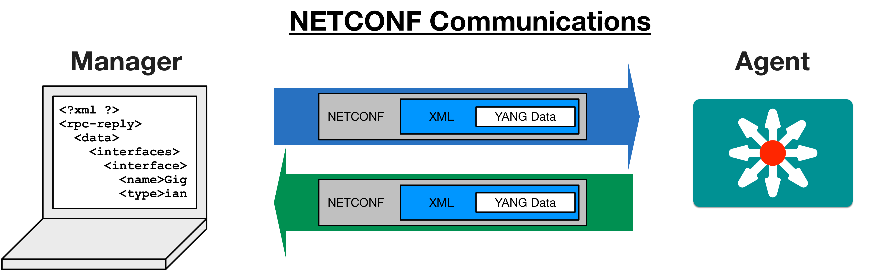
Actual Device Data Modeled in YANG
request
or RESTCONF
or JSON (with RESTCONF)
reply
or RESTCONF
or JSON (with RESTCONF)
Network Device
Network Operator’s PC or an NMS
Notes:
Okay, we have a language (YANG) with which we can create data models (YANG Module), but what we are actually interested in is data about the network.
In the "Foundation Topics" section, we discussed how we will leverage a "Transport Protocol" to communicate from our "Client" to a "Server" using a "Data Format".
So, to retrieve (or send) YANG data, we will leverage "NETCONF" (Transport Protocol) to communicate from a "Manager" (Client) on our workstation to an "Agent" (Server) running on a network element using "XML" (Data Format).
This means that when we send or receive data using NETCONF, we will be working with YANG Modeled data represented in XML. In the next lab we'll look more closely at the NETCONF request process, but for now we will use some sample Python scripts from the code samples that output the device information we are looking for.

Slide 39
ietf-interfaces YANG modeled data with XML encoding
Namespace = Capability = Model
<interfaces xmlns="urn:ietf:params:xml:ns:yang:ietf-interfaces">
<interface>
<name>GigabitEthernet1</name>
<description>DON'T TOUCH ME</description>
<type xmlns:ianaift="urn:ietf:params:xml:ns:yang:iana-if-type">ianaift:ethernetCsmacd</type>
<enabled>true</enabled>
<ipv4 xmlns="urn:ietf:params:xml:ns:yang:ietf-ip">
<address>
<ip>10.10.10.48</ip>
<netmask>255.255.255.0</netmask>
</address>
</ipv4>
<ipv6 xmlns="urn:ietf:params:xml:ns:yang:ietf-ip"/>
</interface>
<interface>
<name>GigabitEthernet2</name>
<type xmlns:ianaift="urn:ietf:params:xml:ns:yang:iana-if-type">ianaift:ethernetCsmacd</type>
<enabled>true</enabled>
<ipv4 xmlns="urn:ietf:params:xml:ns:yang:ietf-ip"/>
<ipv6 xmlns="urn:ietf:params:xml:ns:yang:ietf-ip"/>
</interface>
</interfaces>
Leaf
interface node
interfaces container
Notes:
You should recognize the YANG Model elements represented:
container interfaces
<interfaces xmlns="urn:ietf:params:xml:ns:yang:ietf-interfaces">...</interfaces>
The attribute xmlns="urn:ietf:params:xml:ns:yang:ietf-interfaces"identifies the particular YANG Model
list of individual interfaces
<interface>..</interface>
leaf attributes
<name>..</name>
<type>..</type>>
<enabled>..</enabled

Slide 40
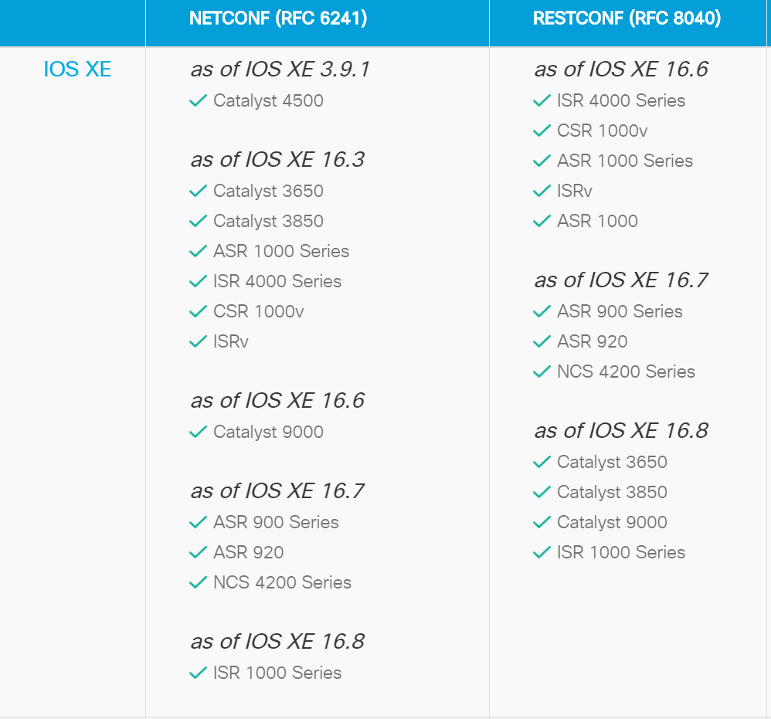
Enable YANG/NETCONF/RESTCONF support
Enabling NETCONF & RESTCONF:
R1(conf)# netconf-yang
R1(conf)# restconf
R1(conf)# ip http secure-server
R1(conf)# ip http authentication local
R1(conf)# username X priv 15 pass Y
List of devices and operating systems with MDP support: https://developer.cisco.com/site/standard-network-devices/
Notes:
MDP = Model Driven Programmability

Slide 41
YANG Summary

Slide 42
YANG Summary
YANG is a Data Modeling Language
Defines the structure, syntax and validation rules for device data
Separates device models from transport protocols and data encodings
YANG Modules are constructed to create standard data models for network data
YANG Data sent to or from a network device will be formatted in either XML or JSON depending on the protocol (ex: NETCONF or RESTCONF)

Slide 43
RESTCONF REST APIs

Slide 44
REST APIs
Use HTTP protocol methods and transport
API endpoints exist as server processes that are accessed through URIs
Webpages present data and functionality in human-machine interaction driven by a user.
APIs present data and functionality in machine-machine interactions driven by software.
Directory of Public APIs: https://www.programmableweb.com/apis/directory
Notes:
APIs enable vendors to provide data services to other vendors across the web. For example, Google provides APIs to other vendors. A vendor such as Amazon can access users' search history on Google and identify products that a user may have searched for. These searches can then inform Amazon as to which product offerings it should push to a specific user based on their interests. All of this is done in software. Amazon has code that accesses the Google API, analyzes the search history for thousands, or millions, of users, and identifies offerings that can be pushed to individual users, perhaps on Facebook, based on their Facebook's API. These API services allow a business to monetize its data by offering it to other businesses in a way that it can easily be utilized. Rather than a company buying data from another company and storing it, the data can be accessed directly from the owner's storage resources.
While individual users request webpages with browsers, and web servers respond by returning text, graphics, and media based on the pages requested, APIs enable machines to talk to machines using software in much the same way. Many types of data are returned, but most often it is in the form of text-based data formats like XML or JavaScript object notation (JSON).

Slide 45


How does this work?
Request
GET https://{RESTCONFDEVICE}/restconf/...
Send me your configuration.
Here’s my conf in XML/JSON.
3rd Party
Application
Response
HTTP 200 OK {xml/json data}
RESTCONF API Endpoint
Notes:
An application is used to issue requests to a server that is accepting HTTP requests. This API has different functionalities depending on the endpoint, or URI that is used. The endpoints can be identified by paths that are appended to the URL. Each endpoint can may have different requirements for the format of the REST request. These requirements are available in the API documentation that is provided to developers.

Slide 46
Anatomy of a REST Request
REST requests require the following elements (requirements may differ depending on the API):
Method
GET (retrieve), POST (create), PUT (update), DELETE (remove), PATCH (partial-update)
URL
Example: http://{RESTCONFDEVICE}/restconf/data/ietf-interfaces
Authentication
Basic HTTP, OAuth, none, Custom
Custom Headers
HTTP Headers
Example: Content-Type: application/json
Request Body
JSON or XML containing data needed to complete request
Notes:
REST requests require the HTTP method and the URI for the API endpoint. For example, the HTTP GET method is used to retrieve some information, such as a list of IOS versions that are being used in the network infrastructure. The POST method is used to create new objects, such as a new authentication ticket or a new QoS policy. The PUT method is used to update existing objects, such as updating the QoS policy and the DELETE method is used to remove existing objects.
Some, but not all, requests require some sort of authentication. Custom HTTP headers are also used to identify the content type for the request body and other parameters. The body of the request may also be required to carry details of the request. APIs differ in their requirements. The first step in working with an API is to review the documentation.

Slide 47
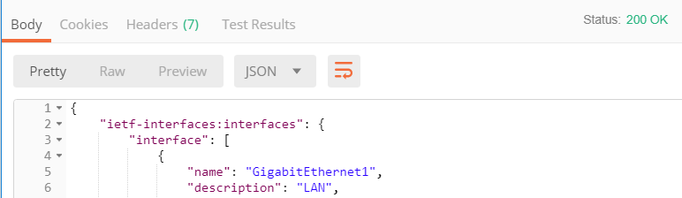
What is in the Response?
HTTP Status Codes
http://www.w3.org/Protocols/HTTP/HTRESP.html
200 OK
201 Created
401, 403 Authorization error
404 Resource not found
500 Internal Error
Headers
Body
JSON
XML
Example output of a HTTP response in the Postman application
Notes:
HTTP status codes are returned for each request. A code such as 200 or 201 indicates a successful request. The familiar “404 resource not found” error can indicate that the URI that was used to make the request contains an error, or that the path to the endpoint has changed. 401 or 403 errors indicate that authentication requirements have not been met. Coders extract the status code from the response and write code to take action based on it.
As shown in the graphic, important information may also be returned in the header. Large amounts of data are usually returned in the body of the response either as JSON or XML.
The image in the slide shows an example response body. The response status is 201 and JSON-formatted data is contained in the body of the response.

Slide 48
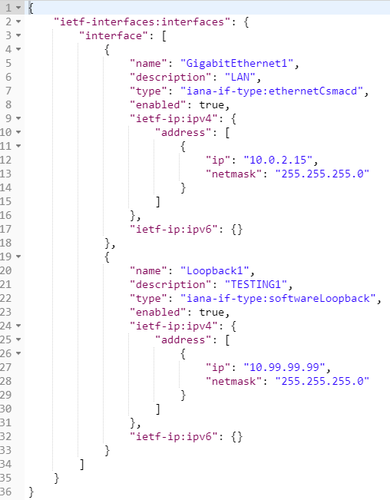
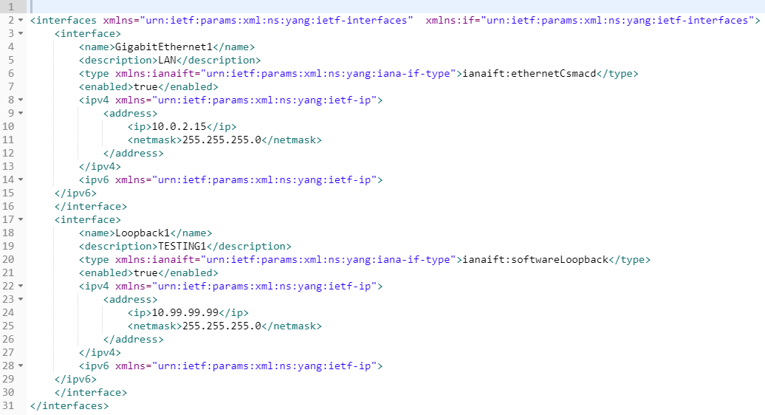
JSON and XML encoding for data
XML
JSON
Notes:
The figure shows actual data returned by the RESTCONF service on an Cisco IOS-XE device. On the left is the JSON data as it was returned. On the right is the equivalent data formatted as XML. Note that XML is slightly more verbose that JSON because it uses paired open and close tags for each entry.

Slide 49
What about authentication?
Basic HTTP: The username and password are passed to the server in an encoded string.
OAuth: Open standard for HTTP authentication and session management. Creates an access token associated to a specific user that also specifies the user rights. The token is used to identify the user and rights when making APIs calls in order to verify access and control.
Token: A token is created and passed with each API call, but there is no session management and tracking of clients, which simplifies interaction between the server and client.
→ RESTCONF on IOS-XE uses Basic HTTP for authentication management.

Slide 50
Experimenting with RESTCONF

Slide 51
RESTCONF Details
“an HTTP-based protocol that provides a programmatic interface for accessing data defined in YANG…”
https://tools.ietf.org/html/rfc8040
RFC 8040 - January 2017
Uses HTTPS for encrypted transport
Tightly coupled to the YANG data model definitions
Provides JSON or XML data formats

Slide 52
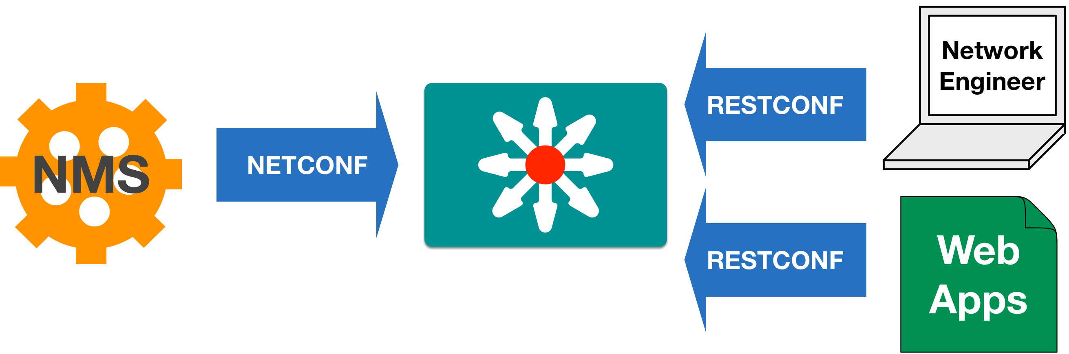
RESTCONF vs. NETCONF?
YANG
Data
Python script
YANG
Data
YANG
Device
Models
YANG
Data
Postman
YANG
Data
YANG
Data
YANG
Data
YANG
Data
RESTCONF and NETCONF are transporting the same YANG device data.
RESTCONF as a RESTful API interface provides an easy entry point for new developers, while NETCONF is a more robust, but also more complex protocol with advanced features that might be required in large scale systems.
Notes:
RESTCONF is NOT a replacement for NETCONF. RESTCONF provides an API that aligns with other Web Application APIs to provide an easy entry point for developers. Though the gaps maybe eventually be filled, today RESTCONF lacks complete feature parity with NETCONF.
More likely we will see both NETCONF and RESTCONF leveraged sumulataneously by different clients.

Slide 53
RESTCONF Transport
Ethernet
IPv4/IPv6
TCP
H T T P S
RESTCONF
YANG DATA encoded in JSON or XML

Slide 54
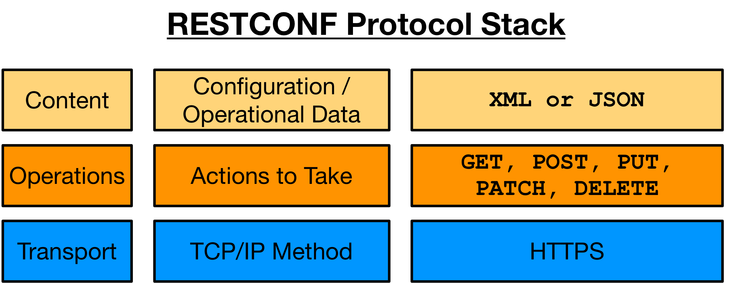
RESTCONF Protocol Stack & Transport
Notes:
Transport - HTTP
Like other REST APIs, RESTCONF leverages the HTTP protocol to encapsulate and send messages. Authentication is accomplished using typical HTTP Authentication models such as Basic Authentication where usernames and passwords are encoded in BASE64 and transmitted in a Header.

Slide 55
Operations - HTTP CRUD
RESTCONF | NETCONF
GET | <get> , <get-config>
POST | <edit-config> (operation="create")
PUT | <edit-config> (operation="create/replace")
PATCH | <edit-config> (operation="merge")
DELETE | <edit-config> (operation="delete")
Notes:
REST APIs typically implement CRUD (Create, Retrieve, Update, and Delete) operations leveraging HTTP available methods. RESTCONF maps the NETCONF operations into these HTTP methods as shown in this table.

Slide 56
Content - XML or JSON
HTTP Headers
Content-Type: Specify the type of data being sent from the client
Accept: Specify the type of data being requested by the client
RESTCONF MIME Types
application/yang-data+json
application/yang-data+xml
Notes:
One of the major advantages RESTCONF has over NETCONF is it's ability to leverage JSON as a data format. Many developers prefer JSON over XML due to easier readability and lower overhead.
When crafting a RESTCONF request, you must specify the data format being sent, and requested by the Agent. This is done in the typical HTTP way, using request headers.
Content-Type: Specify the type of data being sent from the client
Accept: Specify the type of data being requested by the client
RESTCONF describes the following MIME types to be used in these headers to indicate the format being requested.
application/vnd.yang.data+json
application/vnd.yang.data+xml

Slide 57
Constructing RESTCONF URIs for Data Resources
https://<ADDRESS>/<ROOT>/data/<[YANG MODULE:]CONTAINER>/<LEAF>[?<OPTIONS>]
ADDRESS - Of the RESTCONF Agent
ROOT - The main entry point for RESTCONF requests. Discoverable at https://<ADDRESS>/.well-known/host-meta
data - The RESTCONF API resource type for data
The “operations” resource type used to access RPC operations available
[YANG MODULE:]CONTAINER - The base model container being used. Providing the module name is optional.
LEAF - An individual element from within the container
[?<OPTIONS>] - optional parameters that impact returned results.
Notes:
One aspect true of all REST APIs is the importance of the URI in identifying the data being requested or configured, and RESTCONF is no exception. One thing unique about RESTCONF is that it lacks any true "API Documentation" that a developer would use to learn about leveraging it. Rather, the YANG Models themselves ARE the API documentation.
All RESTCONF URIs follow this format:
ADDRESS - The IP (or DNS Name) and Port where the RESTCONF Agent is available
ROOT - The main entry point for RESTCONF requests.
Before connecting to a RESTCONF server, you must determine the root
Per the RESTCONF standard, devices should expose a resource called /.well-known/host-meta to enable discovery of root programmatically
However with many devices still operating on DRAFT RESTCONF specs, this may not be fully implemented.
Device documentation should also specify the root path
On the Cisco CSR, this is api
DATA STORE - The data store being queried
[YANG MODULE:]CONTAINER - The base model container being used
Inclusion of the module name is optional
LEAF - An individual element from within the container
[?<OPTIONS>] - Some network devices may support options sent as query parameters that impact returned results.
These options are NOT required and can be omitted
Check device documentation for details on supported parameters
To make the RESTCONF calls, you can use any client application that supports any REST call. A common tool is the Chrome Application Postman. The Linux command line utility "curl" is another great tool for working with REST APIs. We'll show how to use both in these examples.

Slide 58
URL Creation Review
https://<ADDRESS>/restconf/data/ietf-interfaces:interfaces/interface=GigabitEthernet1?depth=unbounded
module: ietf-interfaces
+--rw interfaces
| +--rw interface* [name]
| +--rw name string
| +--rw description? string
| +--rw type identityref
| +--rw enabled? boolean
| +--rw link-up-down-trap-enable? enumeration {if-mib}?
Options Examples:
depth=unbounded Follow nested models to end. Integer also supported
content=[all, config, nonconfig] Query option controls type of data returned.
fields=expr Limit what leafs are returned
Key: https://<ADDRESS>/<ROOT>/data/<[YANG MODULE:]CONTAINER>/<LEAF>[?<OPTIONS>]
Notes:
In this first example we're going to use RESTCONF to investigate the same ietf-interfaces model we've used in the previous labs.
As we learned, the URI is determined by looking at the underlying YANG model. Here is a partial ietf-interfaces Model.
This can be created by pyang -f tree ietf-interfaces.yang

Slide 59

RESTCONF and HTTPS/SSL
Per RFC8040 RESTCONF requires HTTPS for security
HTTPS leverages SSL/TLS certificates to
Encrypt data transmitted between server and client
Verify a sites identity
Encryption accomplished through Private/Public keys in Certificate
Identity is all about “trust” and the “signer” of a certificate
Connection Not Private

Slide 60
Using RESTCONF with Postman

Slide 61
Postman: Powerful but Simple REST API Client
Quickly test APIs in GUI
Save APIs into Collections for reuse
Manage multiple environments
Auto generate code from API calls
Standalone Application
https://www.getpostman.com

Slide 62
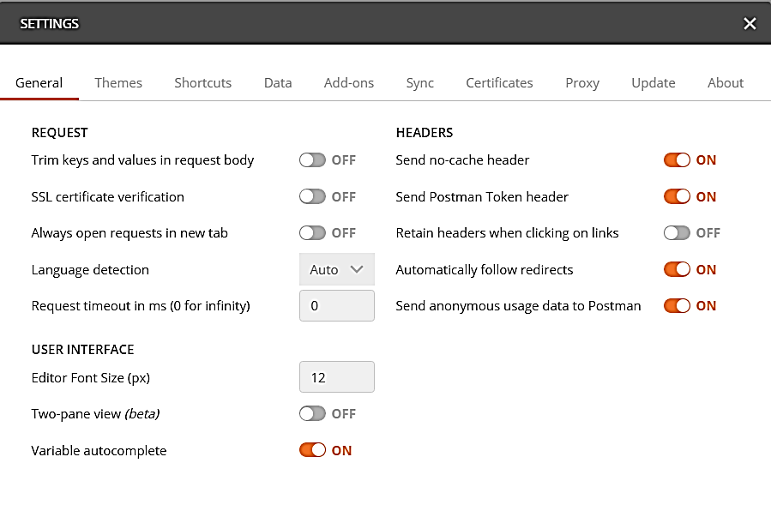
Configure Postman
Due to the self-signed SSL certificates, we need to disable SSL certificate checking. This can cause requests to fail.
Open File>Settings.
Under Request, set SSL Certificate Verification to "OFF"
Notes:
Verification of the router’s self-signed SSL certificate will cause some API requests to fail. Follow the instructions in the slide to disable SSL certificate verification.
Later, when we work with Python, we will use a Python command to do essentially the same thing.

Slide 63
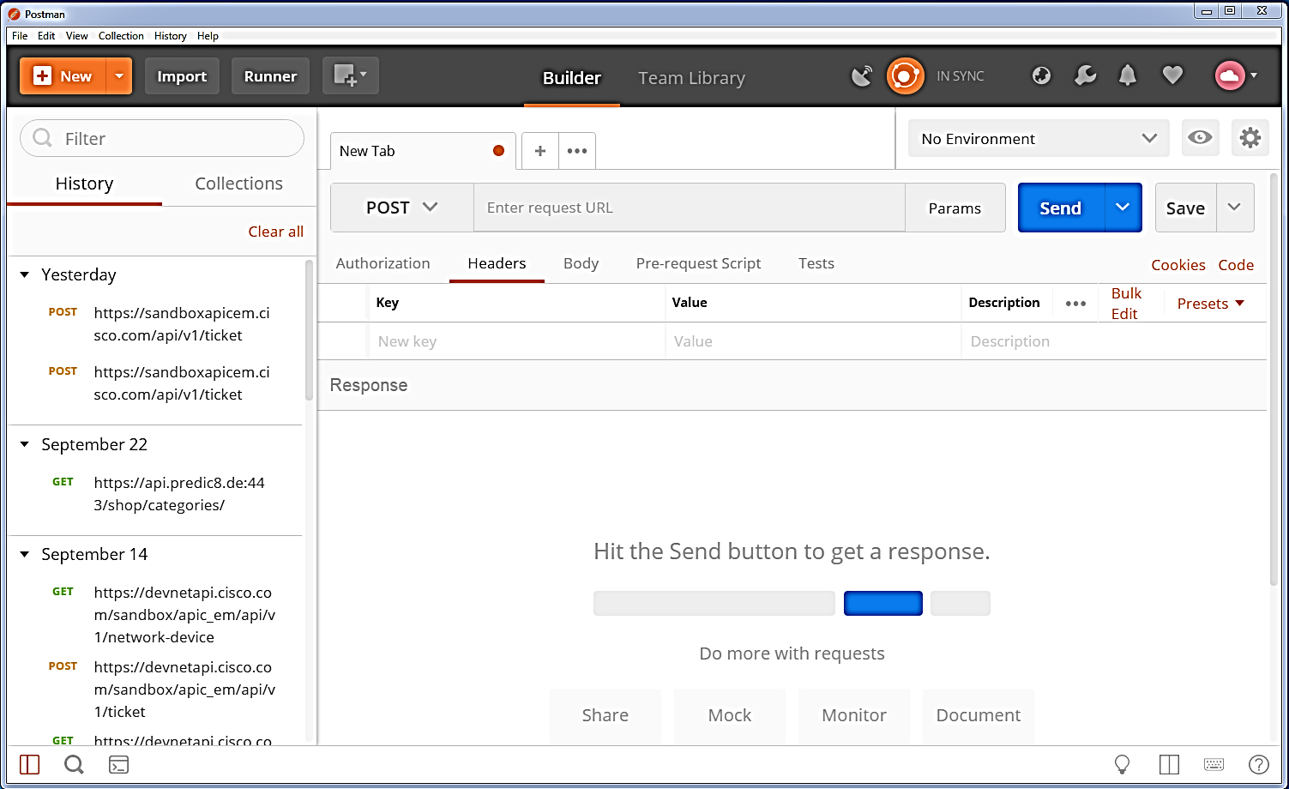
Postman Features
History
Tabs
Collections
Presets
Code
Environments
Collaboration
request
response
Notes:
Postman is a really nice application. It is thoughtfully designed and has many convenience features. For example:
History - Postman retains a list of recent requests.
Tabs - New tabs can be created and reused for different requests that may be used in a session.
Collections - Collections of API requests can be created, imported or shared.
Presets - Commonly used settings can be added as presets and easily accessed by typing a shortcut
Environments - Enables a set of variables to be defined for frequently used values. Multiple environments templates can be created invoked for different needs.
Collaboration - Postman allows for the creation of shared team libraries for collections and environment templates. Changes to the library are monitored and shared with the team. Collaboration is important for software developers, so this feature is a good one to use with students.
The Postman interface is divided into major sections, the upper request section and the lower response section. You configure and send requests in the upper pane. The response status and JSON response body is displayed in the lower pane.

Slide 64
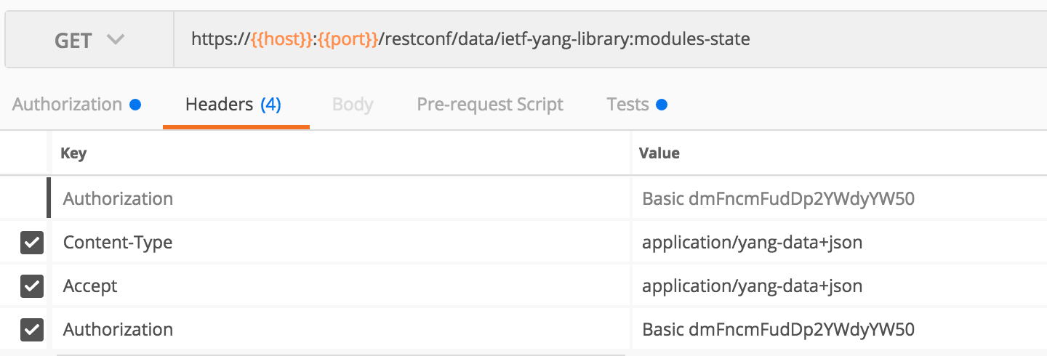
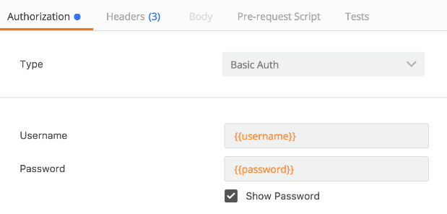
Step 1: Get YANG Modules List via RESTCONF
GET /restconf/data/ietf-yang-library:modules-state
Add RESTCONF Headers
Content-Type and Accept application/yang-data+json (or xml)
Configure Basic Auth with username and password in the Authorization tab

Slide 65
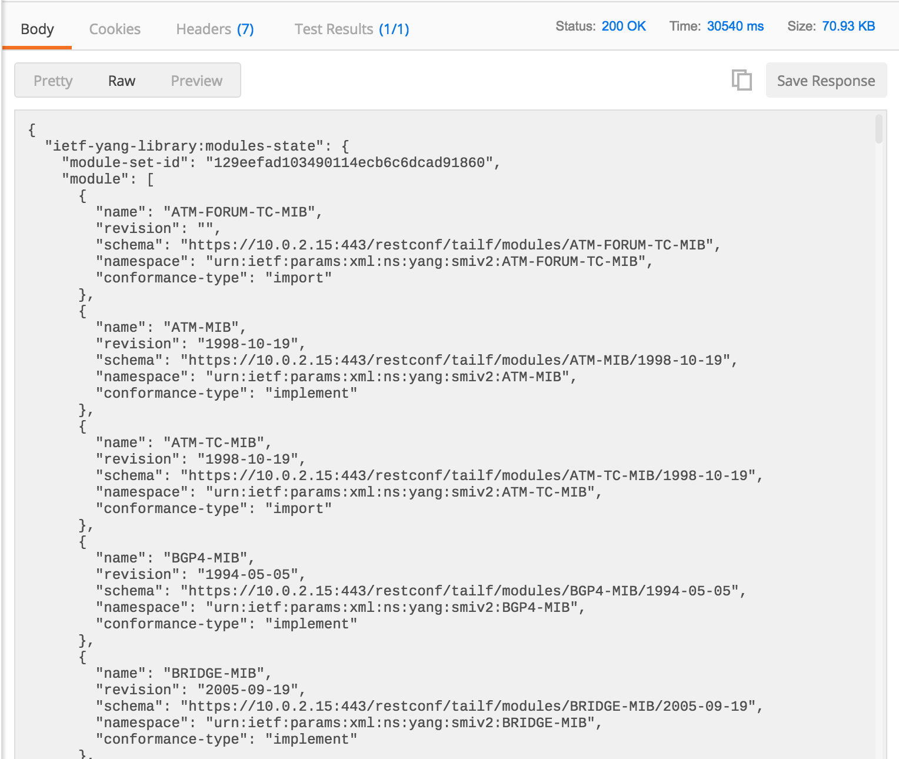
Step 1: Get YANG Models List via RESTCONF
Send and review results
List of supported YANG models

Slide 66
Automate Your Network with RESTCONF

Slide 67
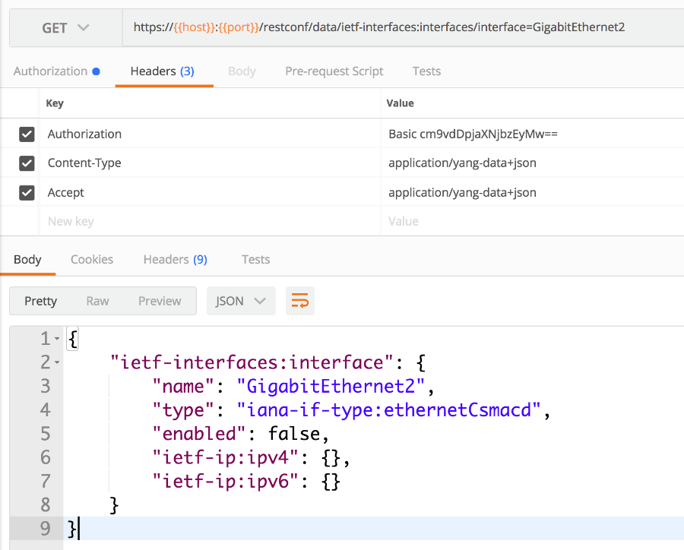
Getting Interface Details
GET restconf/data/ietf-interfaces:interfaces/interface=GigabitEthernet2
YANG DATA encoded as JSON

Slide 68
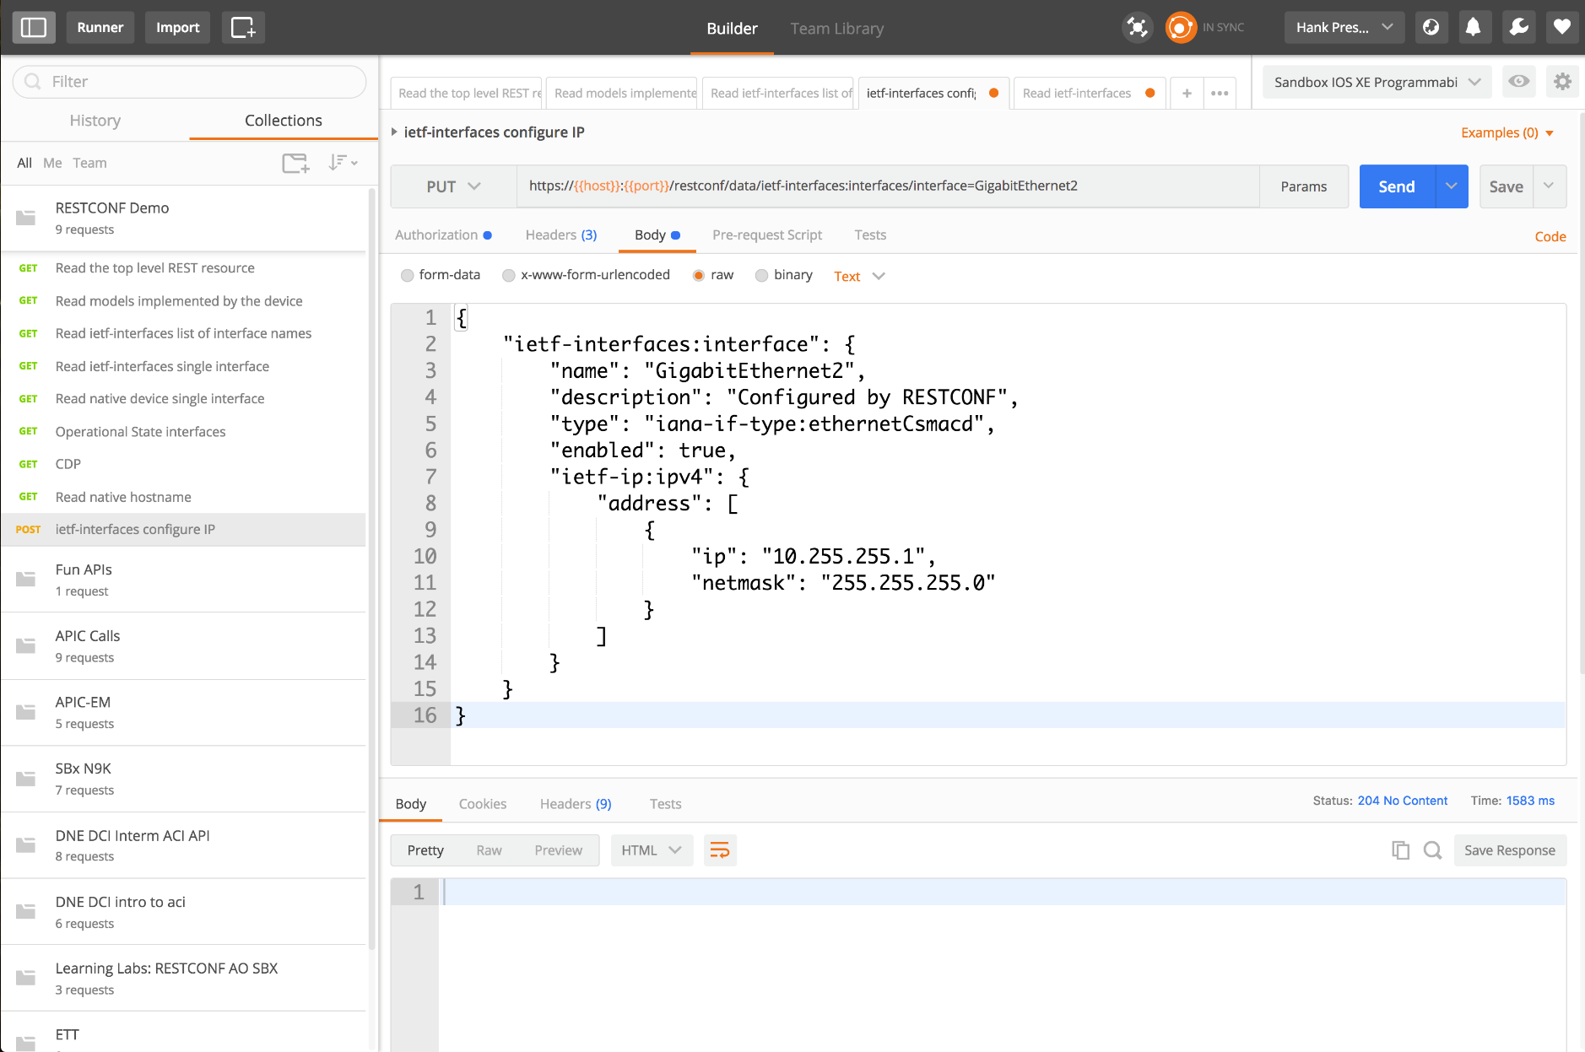
Configuring Interface Details
PUT restconf/data/ietf-interfaces:interfaces/interface=GigabitEthernet2
Configure Body (raw)
Send and check status code
YANG DATA encoded as JSON
Notes:
{
"ietf-interfaces:interface": {
"name": "GigabitEthernet2",
"description": "Configured by RESTCONF",
"type": "iana-if-type:ethernetCsmacd",
"enabled": true,
"ietf-ip:ipv4": {
"address": [
{
"ip": "10.255.255.1",
"netmask": "255.255.255.0"
}
]
}
}
}

Slide 69
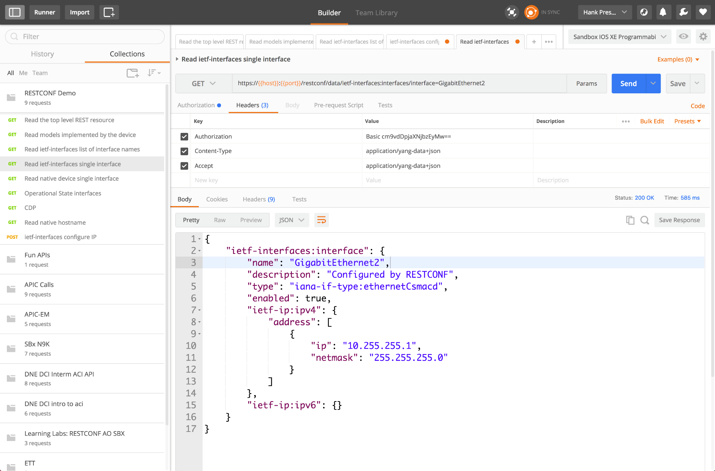
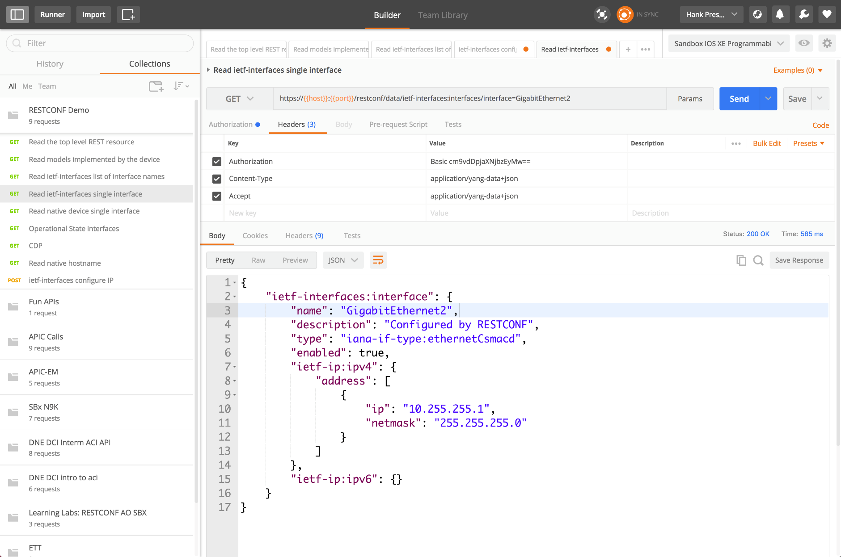
Verification of Interface Details after Configuration
GET restconf/data/ietf-interfaces:interfaces/interface=GigabitEthernet2
Verify that the new config was successful
YANG DATA encoded as JSON

Slide 70
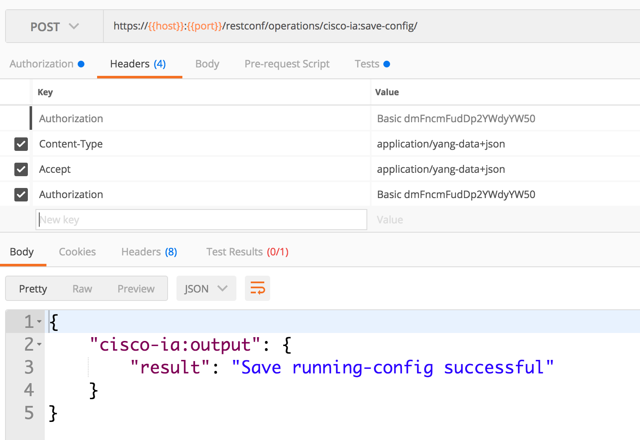
Custom RESTCONF Operations
E.g. Save Running Configuration to Startup RPC Operation
POST restconf/operations/cisco-ia:save-config/

Slide 71
2.4 LAB – RESTCONF with Postman

Slide 72
What’s the lab about?
Using the “Postman” GUI based tool to play with the REST API interface of a device (RESTCONF)
Collecting device data defined in the ietf-interfaces YANG model
Updating interface configuration

Slide 73
RESTCONF with Python

Slide 74
Postman vs. Python use
 | Postman | Python
Availability | Yes | Yes
Ease of use | Medium | More difficult
Save API calls | Yes | Yes
Reuse | Yes | Yes
Automation | No | Yes
Customization | No | Yes
App integration | No | Yes
Notes:
The Cisco Webex Teams for Developers web site makes it easy to use the Cisco Webex Teams RESTful APIs. Representation State Transfer (REST) is a type of API that uses HTTP operations to interface with software on an API endpoint and submit or request data. The API endpoint responds to a successful request with JavaScript Object Notation (JSON) data.
We will learn about and use some common API calls on the Developers' Reference. Later, we will see how it is to use the same API calls with Postman and Python, both of which have certain advantages. However, Cisco Webex Teams for Developers is an easy to use portal, and a great place to learn all the features of the different Cisco Webex Teams APIs.

Slide 75
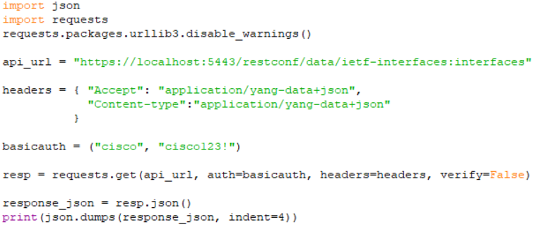
RESTCONF with Python
More flexibility than Postman
Can ask for input parameters on every execution
Code reusability, can run the same Python code on my PC, on a server, etc.
Python’s “requests” module makes it easy to work with REST APIs

Slide 76
2.5 LAB – RESTCONF with Python

Slide 77
What’s the lab about?
Write simple Python scripts to interact with the REST API interface of the device (RESTCONF)
Collecting device data defined in the ietf-interfaces YANG model
Updating interface configuration

Slide 78
RESTCONF Summary

Slide 79
Review
The elements of the RESTCONF transport protocol
How to leverage Postman and Python to use RESTCONF
Examples retrieving and configuring data using RESTCONF

Slide 80
Experimenting with NETCONF

Slide 81
Introducing the NETCONF Protocol
Some key details:
Initial standard in 2006 with RFC4741
Latest standard is RFC6241 in 2011
IANA Port TCP/830
Has more features compared to RESTCONF, but can be also more complex.
Uses XML encoded data.
Notes:
NETCONF is the primary transport protocol used with YANG data models today. It is the NETwork CONFiguration protocol, and defines how a Manager and Agent will communicate in a standard fashion.
Some key details:
Initially standardized in 2006 with RFC4741
Latest standard is RFC6241 in 2011
Does NOT explicitly define content. That is what YANG provides.

Slide 82
RESTCONF vs. NETCONF?
YANG
Data
Python script
YANG
Data
YANG
Device
Models
YANG
Data
Postman
YANG
Data
YANG
Data
YANG
Data
YANG
Data
RESTCONF and NETCONF are transporting the same YANG device data.
RESTCONF as a RESTful API interface provides an easy entry point for new developers, while NETCONF is a more robust, but also more complex protocol with advanced features that might be required in large scale systems.
Notes:
RESTCONF is NOT a replacement for NETCONF. RESTCONF provides an API that aligns with other Web Application APIs to provide an easy entry point for developers. Though the gaps maybe eventually be filled, today RESTCONF lacks complete feature parity with NETCONF.
More likely we will see both NETCONF and RESTCONF leveraged sumulataneously by different clients.

Slide 83
NETCONF Transport
Ethernet
IPv4/IPv6
TCP
S S H
NETCONF
YANG DATA encoded in XML

Slide 84
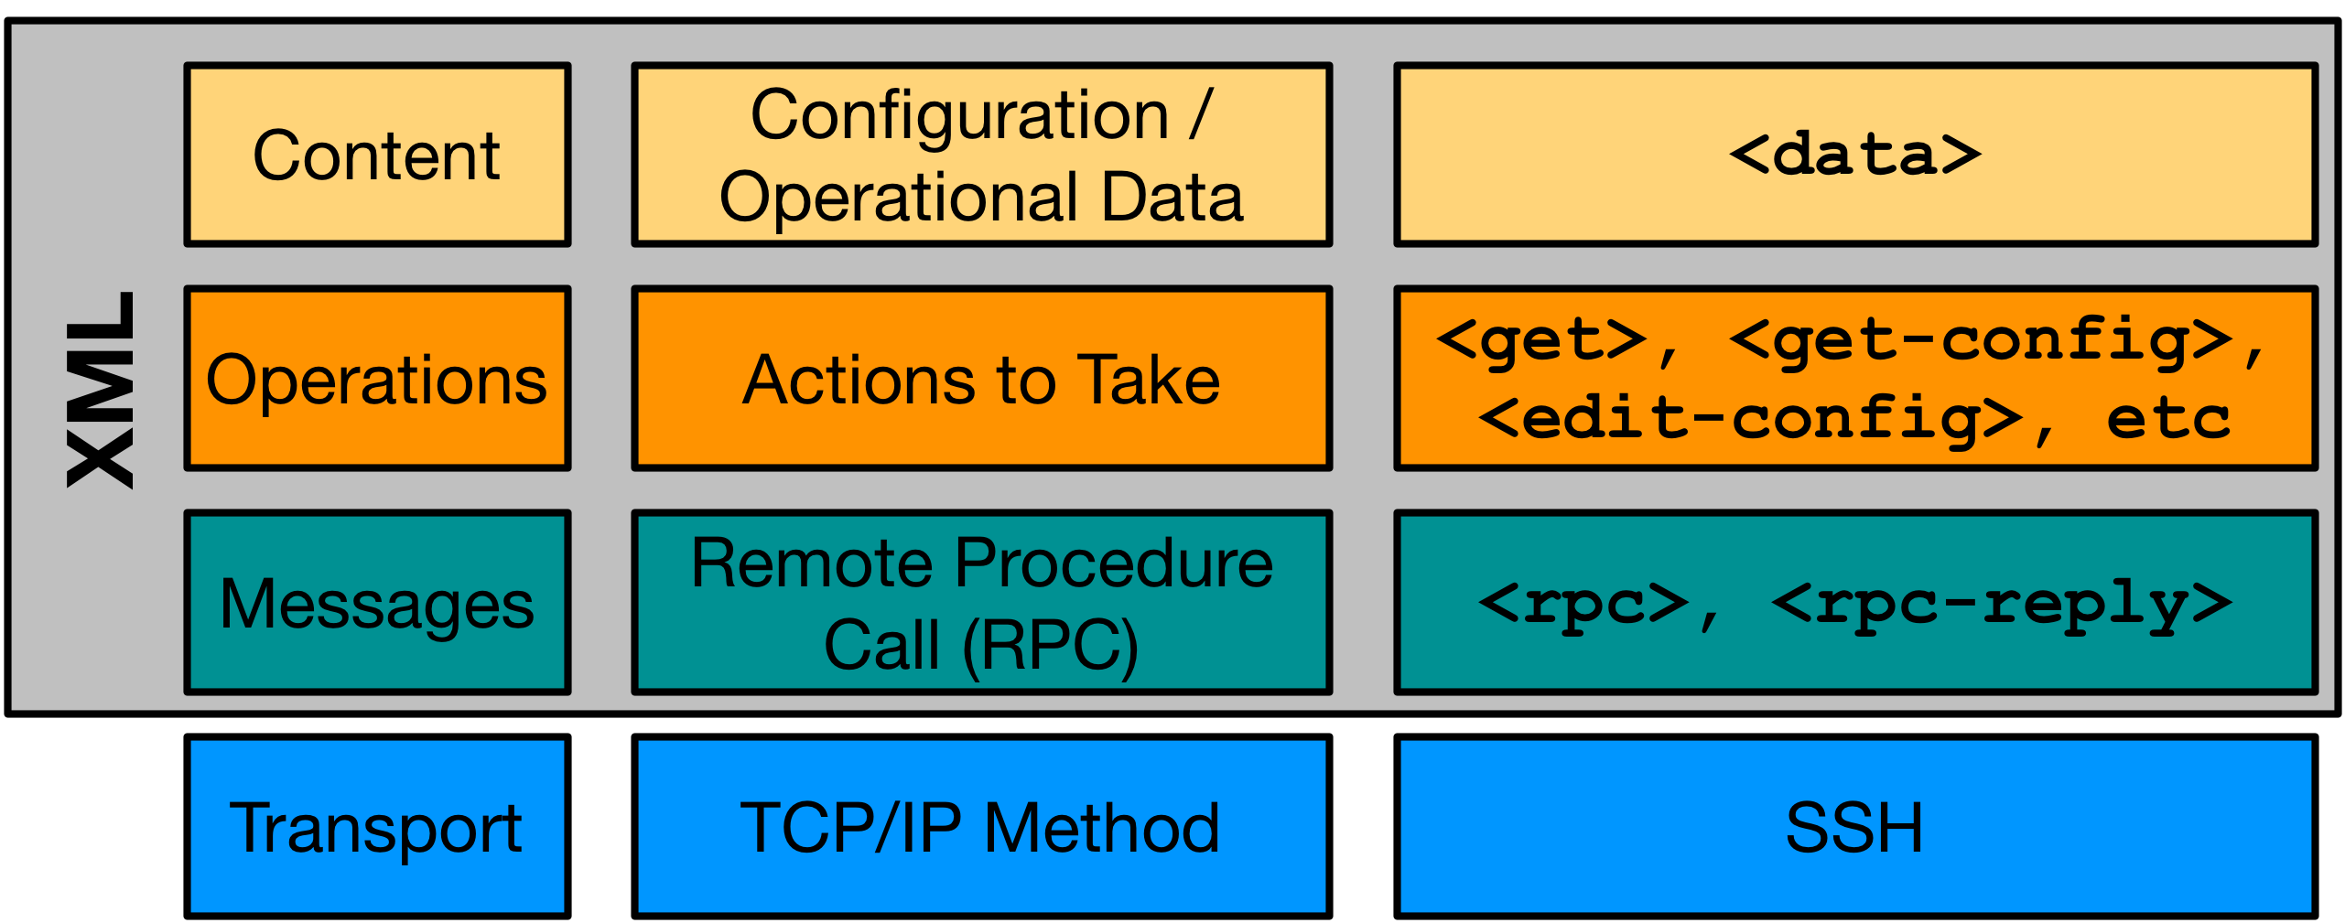
NETCONF Protocol Stack
Notes:
As a Transport Protocol, NETCONF has a layered approach that defines how the Manager (client) and Agent (server) will communicate. Starting from the bottom:

Slide 85
Transport - SSH
$ ssh admin@192.168.0.1 -p 830 -s netconf
admin@192.168.0.1's password:
<hello xmlns="urn:ietf:params:xml:ns:netconf:base:1.0">
<capabilities>
<capability>urn:ietf:params:netconf:base:1.1</capability>
<capability>urn:ietf:params:netconf:capability:candidate:1.0</capability>
<capability>urn:ietf:params:xml:ns:yang:ietf-netconf-monitoring</capability>
<capability>urn:ietf:params:xml:ns:yang:ietf-interfaces</capability>
[output omitted and edited for clarity]
</capabilities>
<session-id>19150</session-id></hello>]]>]]>
<?xml version="1.0" encoding="UTF-8"?>
<hello xmlns="urn:ietf:params:xml:ns:netconf:base:1.0">
<capabilities>
<capability>urn:ietf:params:netconf:base:1.0</capability>
</capabilities>
</hello>]]>]]>
SSH Login
Server (Agent – switch, router, firewall, AP,…) sends hello
Client (Manager – ssh client, Python script, NMS, …) sends its hello too
Example edited for simplicity and brevity
Notes:
NETCONF leverages SSH as the underlying method for communicating over the network. NETCONF authentication options are the same as any SSH communication. Usernames and passwords or certificates can be used just like when you use SSH for CLI communications. In fact, here is an example of NETCONF using the ssh client.
After successfully logging into the NETCONF Agent on the device, it replies back with the list of "capabilities" that are supported. The next step would be to send the "capabilities" that you, acting as the NETCONF Manager" support packaged in XML. It might look something like this:

Slide 86
2.6 LAB – raw NETCONF

Slide 87
What’s the lab about?
Connecting to a NETCONF service on a device
Verifying NETCONF is running
Exploring the XML data structures
Exploring the supported YANG models (capabilities)

Slide 88
Transport - SSH
$ ssh admin@192.168.0.1 -p 830 -s netconf
admin@192.168.0.1's password:
<hello xmlns="urn:ietf:params:xml:ns:netconf:base:1.0">
<capabilities>
<capability>urn:ietf:params:netconf:base:1.1</capability>
<capability>urn:ietf:params:netconf:capability:candidate:1.0</capability>
<capability>urn:ietf:params:xml:ns:yang:ietf-netconf-monitoring</capability>
<capability>urn:ietf:params:xml:ns:yang:ietf-interfaces</capability>
[output omitted and edited for clarity]
</capabilities>
<session-id>19150</session-id></hello>]]>]]>
<?xml version="1.0" encoding="UTF-8"?>
<hello xmlns="urn:ietf:params:xml:ns:netconf:base:1.0">
<capabilities>
<capability>urn:ietf:params:netconf:base:1.0</capability>
</capabilities>
</hello>]]>]]>
SSH Login
You Don’t Need To Use NETCONF Like This!
Server (Agent) sends hello
Client (Manager) sends hello
Example edited for simplicity and brevity
Notes:
NETCONF leverages SSH as the underlying method for communicating over the network. NETCONF authentication options are the same as any SSH communication. Usernames and passwords or certificates can be used just like when you use SSH for CLI communications. In fact, here is an example of NETCONF using the ssh client.
After successfully logging into the NETCONF Agent on the device, it replies back with the list of "capabilities" that are supported. The next step would be to send the "capabilities" that you, acting as the NETCONF Manager" support packaged in XML. It might look something like this:

Slide 89
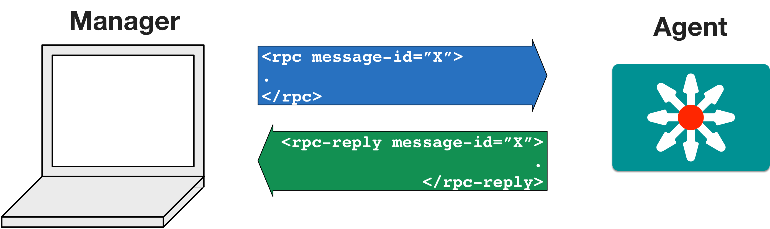
Messages - Remote Procedure Call (RPC)
edit-config(yang-data)
OK –config updated

Slide 90
Operations - NETCONF Actions
Operation | Description
<get> | Retrieve running configuration and device state information
<get-config> | Retrieve all or part of specified configuration data store
<edit-config> | Loads all or part of a configuration to the specified configuration data store
<copy-config> | Replace an entire configuration data store with another
<delete-config> | Delete a configuration data store
<commit> | Copy candidate data store to running data store
<lock> / <unlock> | Lock or unlock the entire configuration data store system
<close-session> | Graceful termination of NETCONF session
<kill-session> | Forced termination of NETCONF session
… | …
Notes:
When making a request of an Agent, there are several possible actions you can take with NETCONF. The action is indicated using an XML tag. They are:

Slide 91
Additional Operations
The IETF isn’t able to anticipate every use case from every vendor.
Additional operations can be defined by the vendor
Support extended through RPC call to vendor-specific YANG model
write mem?
commit?
copy run start?

Slide 92
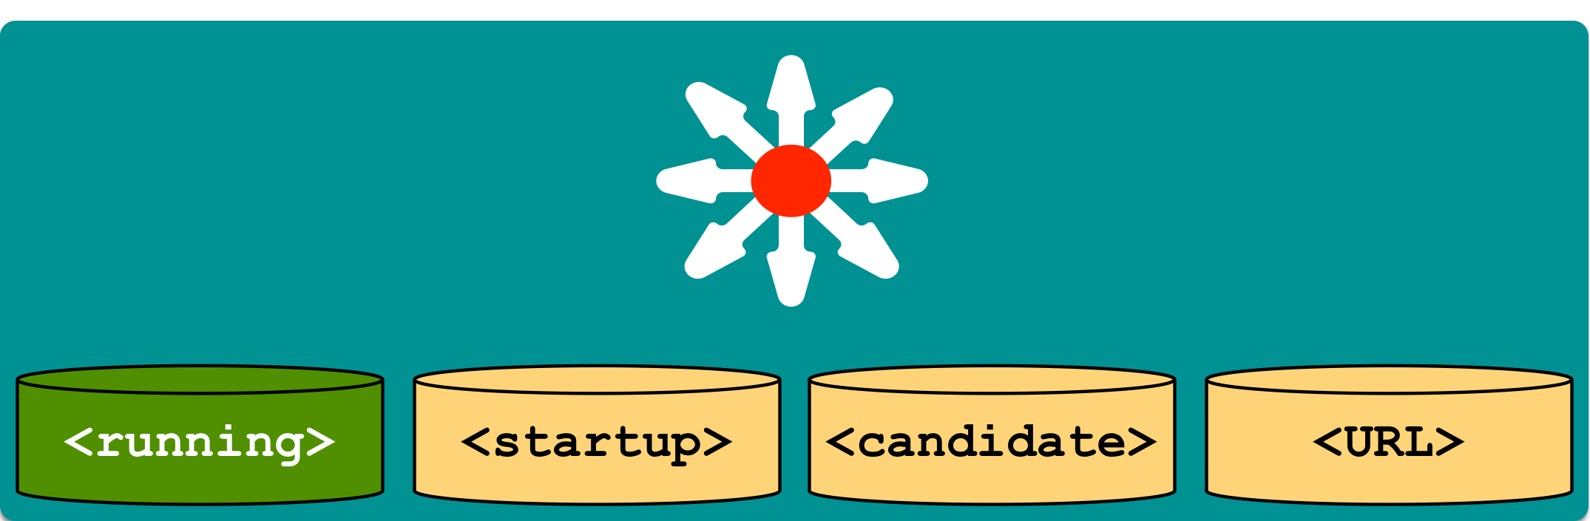
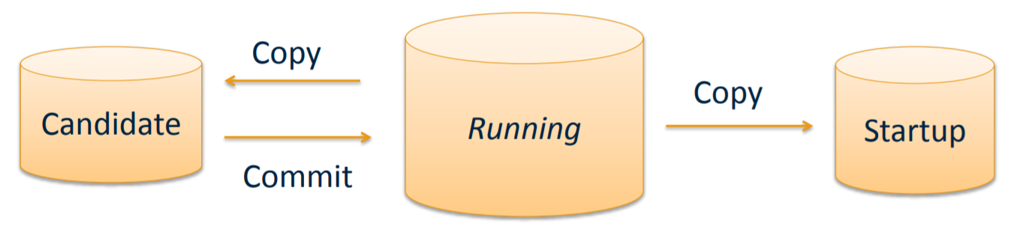
NETCONF Data Stores
Data Store Key Points
Entire or partial configuration
"running" is the only mandatory data store
Not all data stores are writeable
result = m.get_config('running')
Notes:
One of the key requirements identified when the IETF was considering a replacement for SNMP was an integrated method for configuration validation, error checking/handling, and rollback.
As part of addressing this need, NETCONF includes "Data Stores" to provide targets of individual operation events. Each container will hold a copy of the configuration data that can be pre-validated before committing to active configuration.
In the last example, we targeted the "running" data store in this code line:
Another benefit of data stores, is that network management systems can verify that configurations across all devices in a network are consistent in a data store, then commit an entire network-wide change at once.
Data Store Key Points
A container may hold an entire or partial configuration
Not all data stores are supported on all devices
"running" is the only mandatory data store
Not all data stores are writeable
A "URL" data store is supported by IOS to enable <config-copy>
Every NETCONF message must target a data store

Slide 93
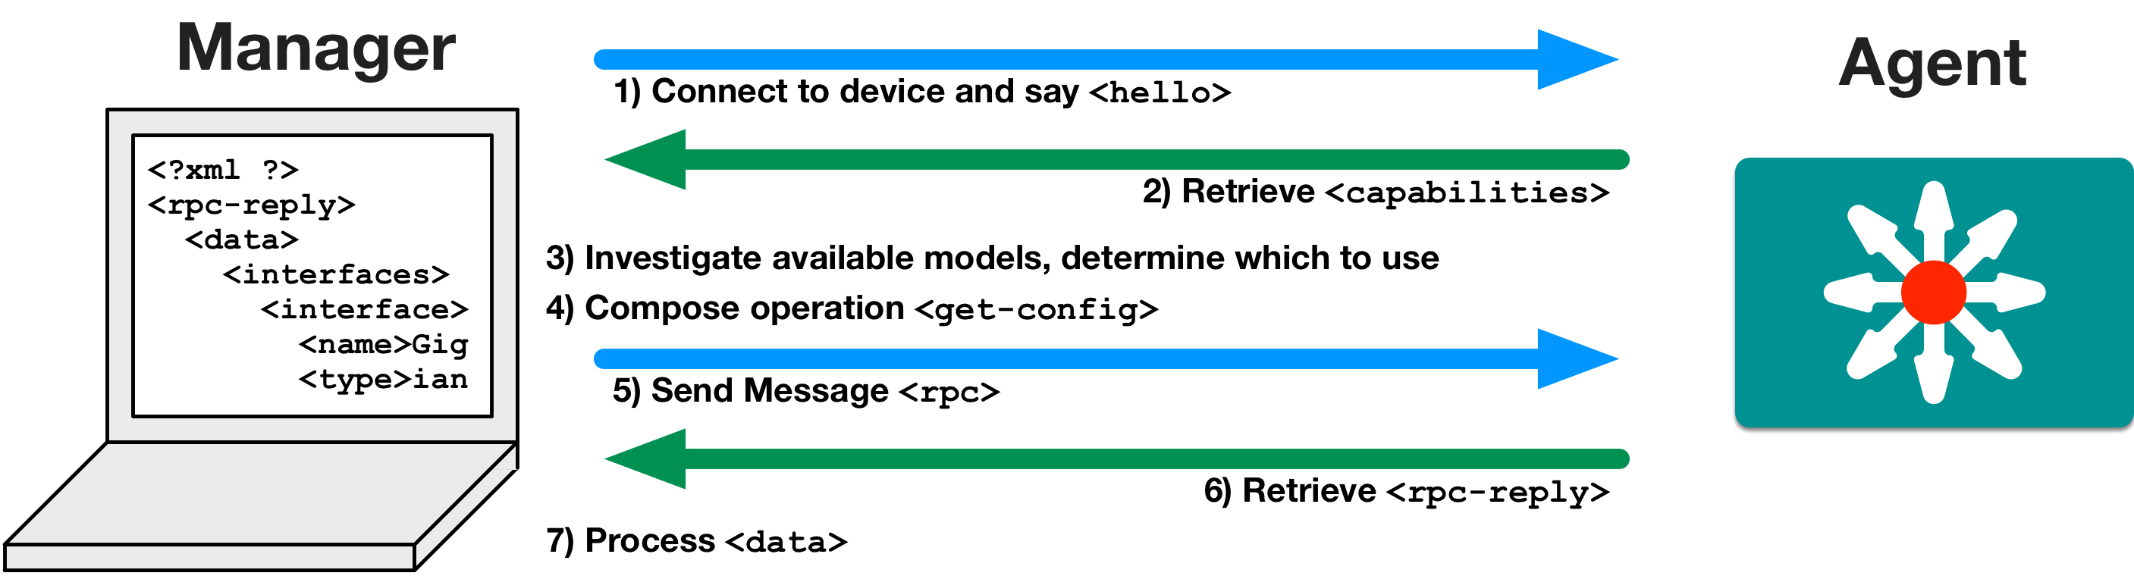
NETCONF Communications
List of my supported YANG models
Notes:
With our solid understanding of the key elements of NETCONF, let's walk through the process a developer will take when using it.
Using a NETCONF Manager, connect to the Agent on a device and say <hello>
The Agent replies with a list of <capabilities>
The developer investigates the available data models provided as capabilities and selects the one that best meets their need.
Compose the XML data that will be sent using an available operation (ex: <get-config>)
Send the message as a Remote Procedure Call <rpc> from the Manager
The Agent sends an <rcp-reply> back
Process the <data> that was included in the reply.
Also, by leveraging tools like ncclient for Python, the developer can focus more on their application elements, than the intricacies of the protocol.

Slide 94
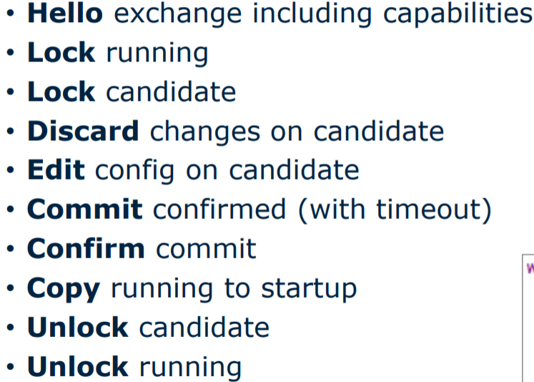
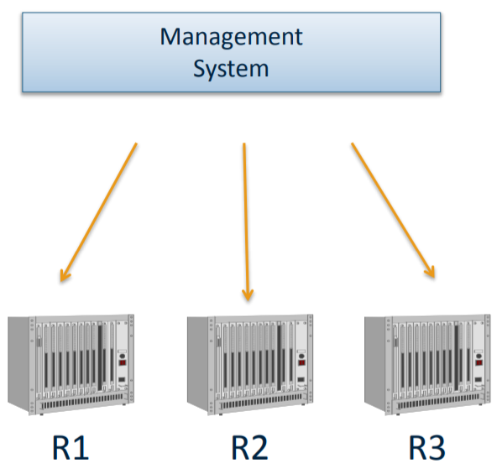
Anatomy of NETCONF Sessions
Single Transaction Session

Slide 95
NETCONF in Code with Python

Slide 96
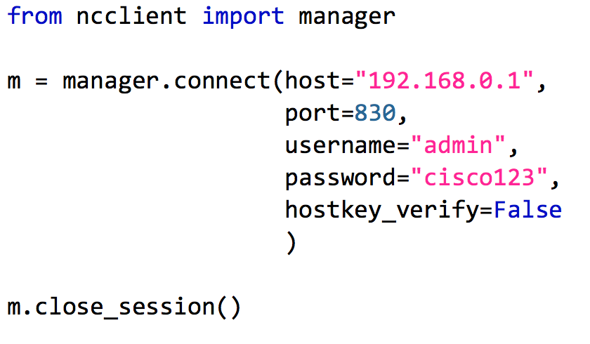
NETCONF and Python: ncclient
Full NETCONF Manager implementation in Python
https://ncclient.readthedocs.io
Simplifies connection and communication.
Deals in raw XML
From: http://ncclient.readthedocs.io/en/latest/
Notes:
Though possible, using NETCONF with an SSH client directly like this example is not typical. More likely you would use a special purpose software application, or programming library, that handles the specifics of sending and processing the raw NETCONF communications.
There are many such pieces of software available for developers to leverage depending on their need and language preferences. In this lab we are going to leverage ncclient, a Python library that
"aims to offer an intuitive API that sensibly maps the XML-encoded nature of NETCONF to Python".
From this point forward, all examples of NETCONF will leverage ncclient and Python scripts.

Slide 97
2.7 LAB – NETCONF with Python: List Capabilities

Slide 98
What’s the lab about?
Using Python’s ncclient module to connect to the NETCONF service of the device
Printing to the output the list of supported YANG models (capabilities)

Slide 99
2.8 LAB – NETCONF with Python: Device Configuration

Slide 100
What’s the lab about?
Using Python’s ncclient module to connect to the NETCONF service of the device
Getting the device’s current configuration
Exploring the XML structure using codebeautify
Using Python’s XML modules to pretty-print the XML data
Updating the device’s configuration
Verifying the transactional behavior of NETCONF when applying incorrect configuration

Slide 101
2.9 LAB – NETCONF with Python: Get Operational Data

Slide 102
What’s the lab about?
Using Python’s ncclient module to connect to the NETCONF service of the device
Getting the device’s operation data defined in the ietf-interfaces YANG model
Printing to the output the interface statistics

Slide 103
NETCONF Summary

Slide 104
NETCONF Summary
The elements of the NETCONF transport protocol
How to leverage ncclient to use NETCONF in Python
Examples retrieving and configuring data from a NETCONF Agent

Slide 105
Security Considerations

Slide 106
Securing the Management Plane and APIs
Enabling new management interfaces, like RESTCONF and NETCONF, also enables new attack vectors unless they get properly secured.
Always implement security best practices
Strong Passwords
ACLs
Limit access to port 80, 443 and 830 only to trusted sources
Configure netconf-yang and restconf service ACLs
Configure ip http server ACLs
VTY ACLs

Slide 107
RESTCONF and NETCONF Service ACLs
ip access-list standard MANAGEMENTNET permit 10.0.1.0 0.0.0.255 ! Management network deny any restconf ipv4 access-list name MANAGEMENTNET netconf-yang ssh ipv4 access-list name MANAGEMENTNET ! Similar for IPv6
As a best practice, also consider:
ip http access-class ipv4 MANAGEMENTNET line vty 0 15 access-class MANAGEMENTNET in
Notes:
https://www.cisco.com/c/en/us/td/docs/ios-xml/ios/prog/configuration/1612/b_1612_programmability_cg/netconf_and_restconf_service_level_acls.html

Slide 108
What’s next?

Slide 109

That was cool… but is that really the way networks will be configured in the future?

Slide 110
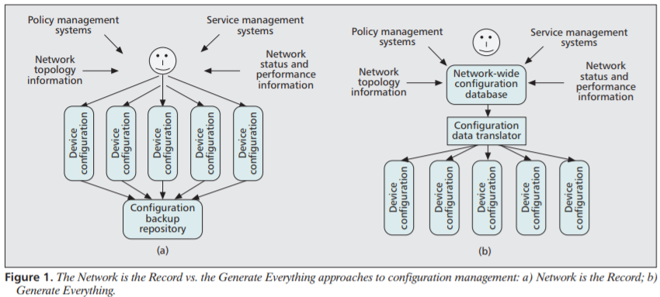
SDN with YANG/NETCONF/RESTCONF
Source: Network Configuration Management Using NETCONF and YANG; Martin Bjorklund, et.al.; IEEE Communications Magazine, September 2010

Slide 111

NETCONF/YANG Used in Other Tools
Management & Orchestration
Configuration Management
Network Controllers
Software Libraries
YANG Development Kit (YDK)
APIC-EM
NAPALM

Slide 112
Next steps…
Go to DevNet, investigate and learn more:
The DevNet Cisco Community
The DevNet Introduction to DevNet interactive course track
http://developer.cisco.com
Notes:
Please visit DevNet and register if you have not already. There are lot of free learning resources there. Explore what they have to offer. DevNet is built to support people as they learn about network programmability with Cisco solutions.
You are always free to access the open DevNet sandbox in order to explore what it has to offer. Don't forget to look at the API documentation for the specific APIs.

